Slide 1
Ransomware, etc.
Don Thomson, CEO

Slide 2
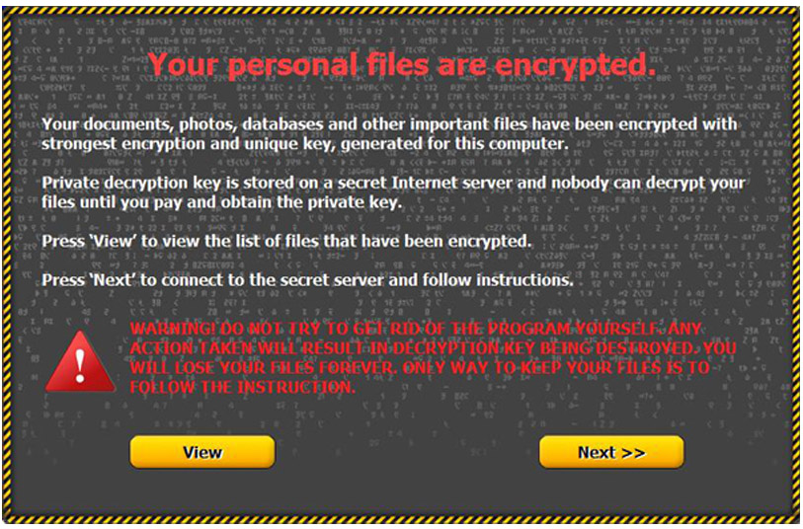
Ransomware

Slide 3
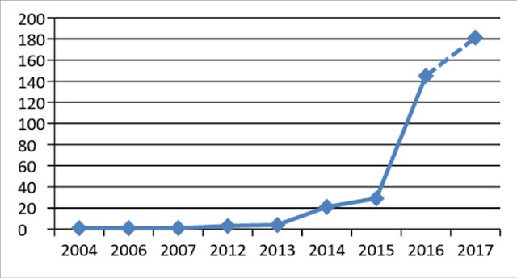
Ransomware
851% growth in the number of ransomware families in 9 months … ransomware as a service

Slide 4
Ransomware
1-2% of Sage 300 companies are infected every month!
Source: Anecdotal

Slide 5
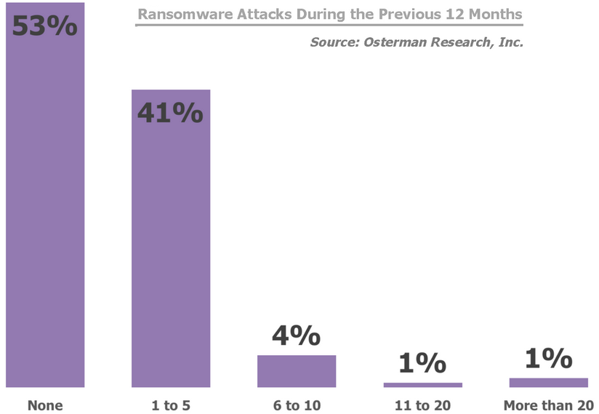
Ransomware

Slide 6
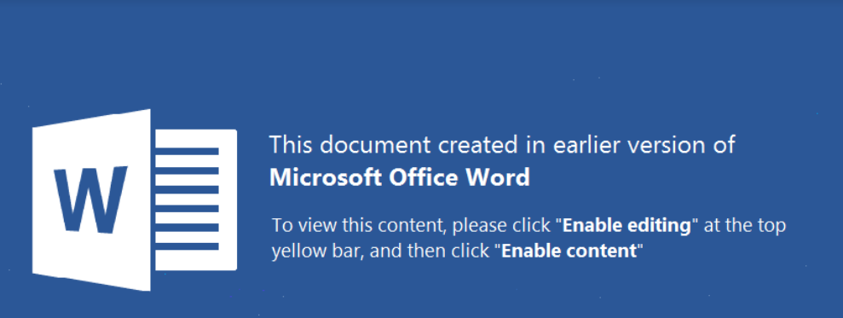
Ransomware – Word Virus Example

Slide 7
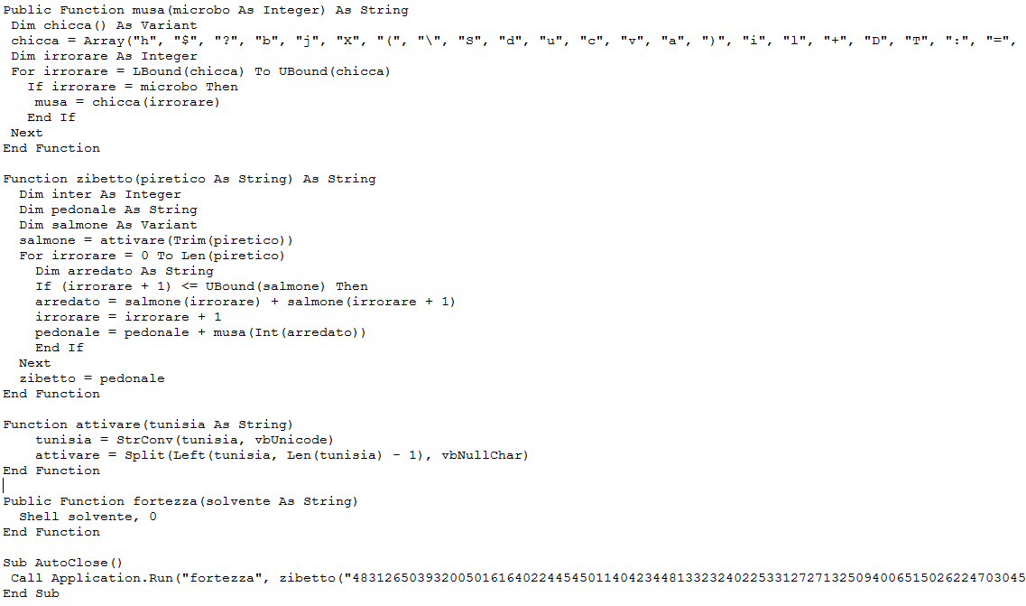
Ransomware – Word Virus Example

Slide 8
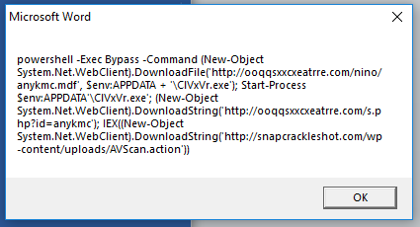
Ransomware – Word Virus Example

Slide 9
Ransomware Affects Us
Increasingly Complex Windows Security
Increasingly Aggressive Anti-Malware Programs

Slide 10
Protection
How long will it take you to rebuild from an offsite (off network) copy of your infrastructure?

Slide 11
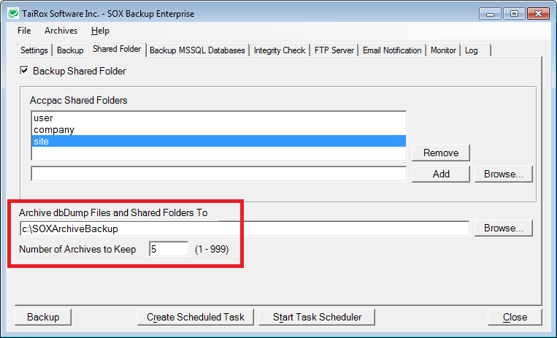
SOX Backup - Protection

Slide 12
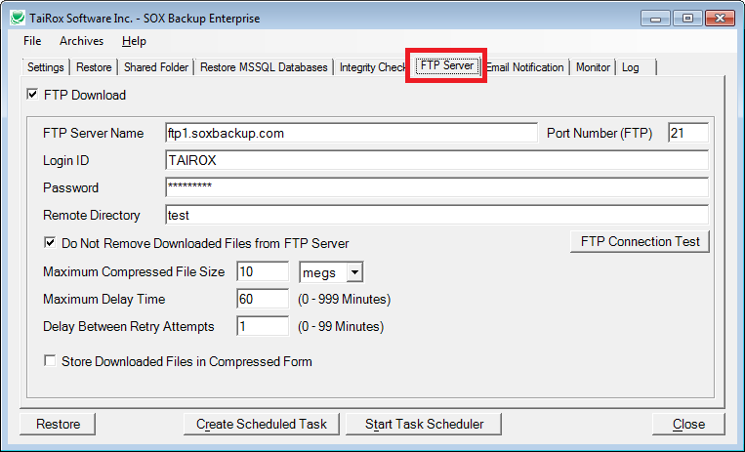
SOX Backup - Protection

Slide 13
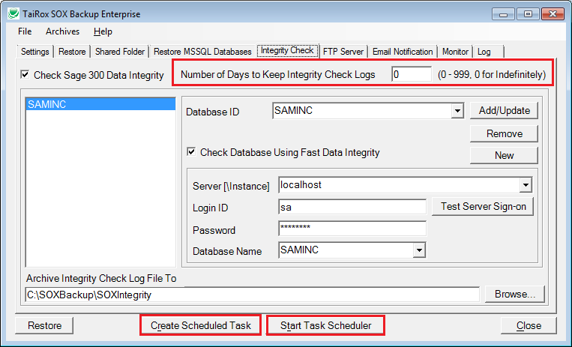
SOX Backup – New Features

