Slide 2
I Wish For …
Easy Money that is terrific value for my customers

Slide 3
Sage CRM/300 Training: Not Easy
HTML
JavaScript
ASP Pages
.NET Pages
Meta-Data

Slide 4
Sage CRM/300 Support: Not Easy

Slide 5
I Wish for Good CRM/300 Behavior
Same Hardware
Same Desktop
Same Licensing Scheme: Lanpaks
Same Database Admin: DBDump & DBLoad
Same Customization Method: Optional Fields
Same Data Format & Sizes
Same Data Activation
Same Users & Permissions
Same Translations
Same Reporting Tools & Versions
Same Software Stack, Icons, Finders, etc.

Slide 6
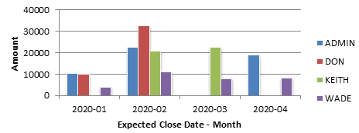
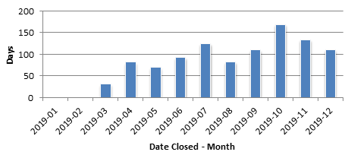
I Wish For … TaiRox CRM

Slide 7
TaiRox CRM General Features
Track opportunities and create dozens of Excel charts.
Track prospect companies and promote to A/R customers.
Track contacts and link to their social media pages.
Track communications with contacts or groups.
Send bulk email to MailChimp and Swiftpage.
Launch linked network & internet documents with one click.
See every change to every entity: who, what, when.
Recover deleted entities from a recycle bin.

Slide 8
Sage 300 Related Features
DBDump and DBLoad all data.
Promote & synch without truncation: data is field-level compatible.
Use optional fields to extend functionality.
Use Sage 300 Lanpaks: no named-user licensing.
Display the sales pipeline using Sage 300 exchange rates.
Link quotes and orders to opportunities.
Use Sage 300 territories to control who sees what.
Use the keyboard and mouse like a Sage 300 user.

Slide 9
TaiRox CRM Modernization Features
Fast!: SQL Server queries search, sort & page
SmartFinders: search like an internet search engine
Paging:
Optional Fields: shown in grids, sortable, searchable
Google Maps: one click shows you company’s location
Social Media: one click opens Skype, etc.
Email Launcher: one click opens Outlook
Change Logs: see who made changes, when

Slide 10
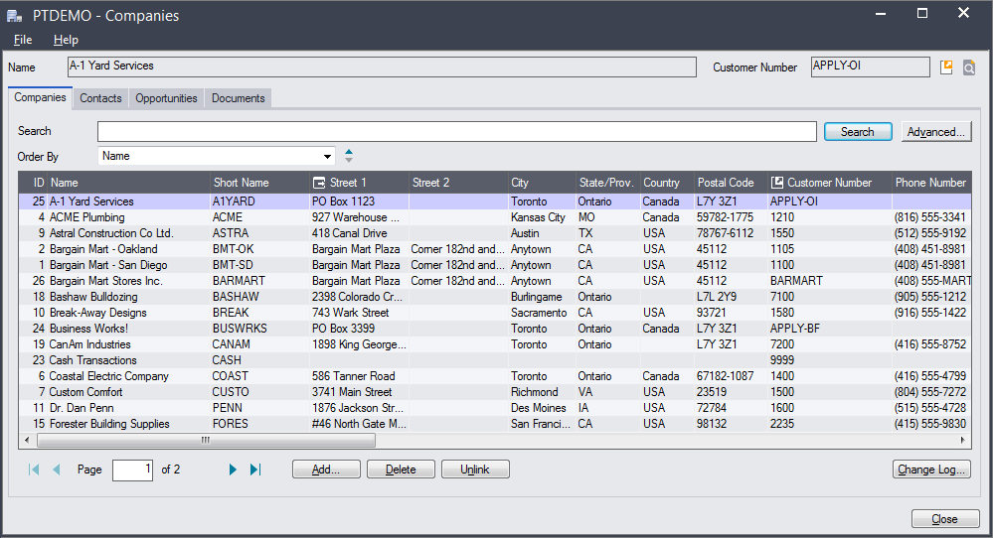
Companies

Slide 11
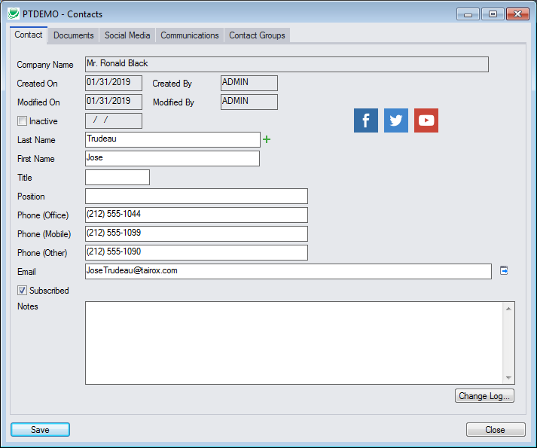
Contacts

Slide 12
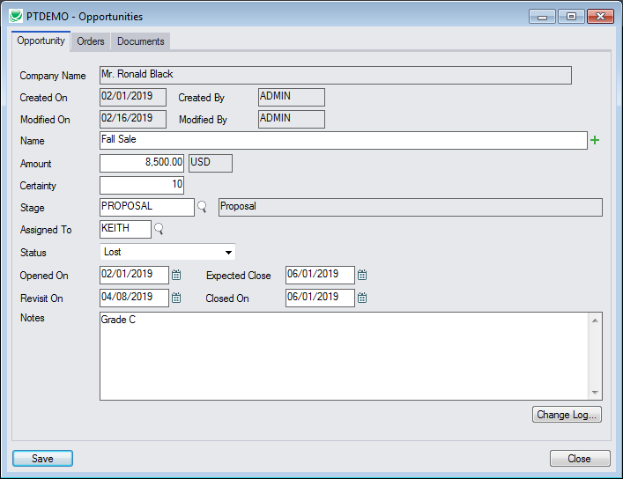
Opportunities

Slide 13
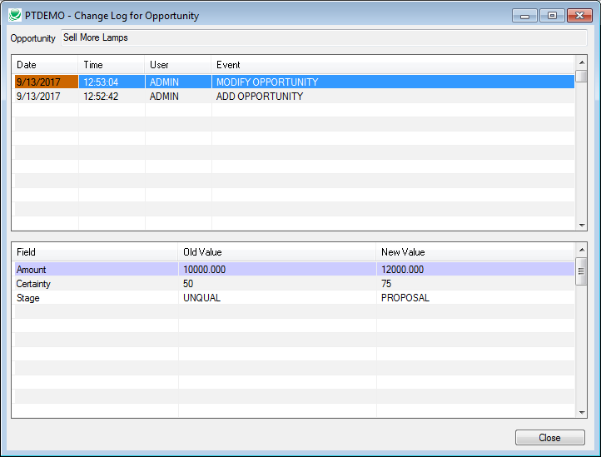
Opportunity Change Log

Slide 14
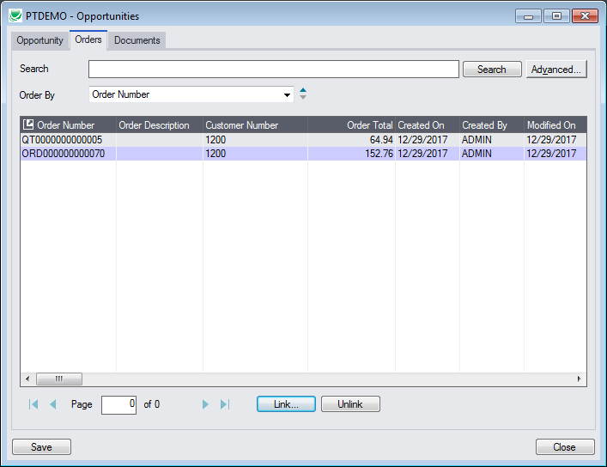
Opportunity: Linked Orders & Quotes

Slide 15
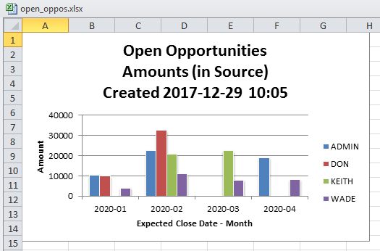
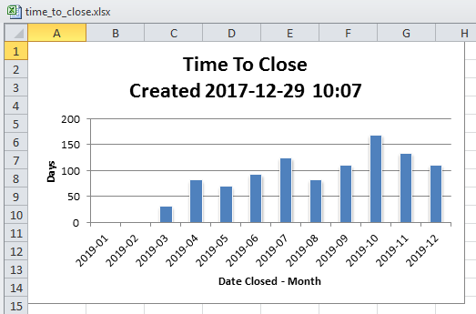
Dozens of Sales Reports

Slide 16
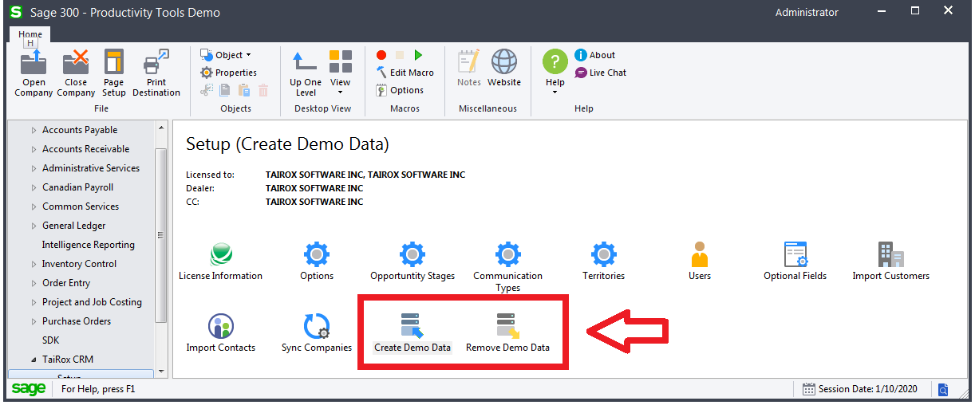
Easy to Demo, Easy to Evaluate

Slide 17
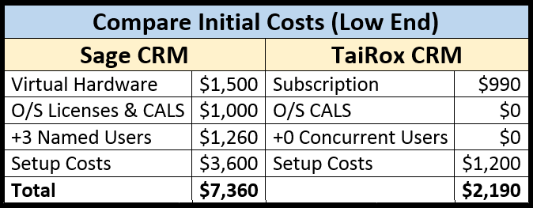
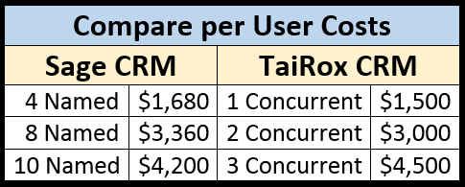
Compare $
Note: Volume discounts kick-in earlier with 1 licensing scheme

Slide 18
Learn More About
http://www.tairox.com

