Slide 1


Slide 2
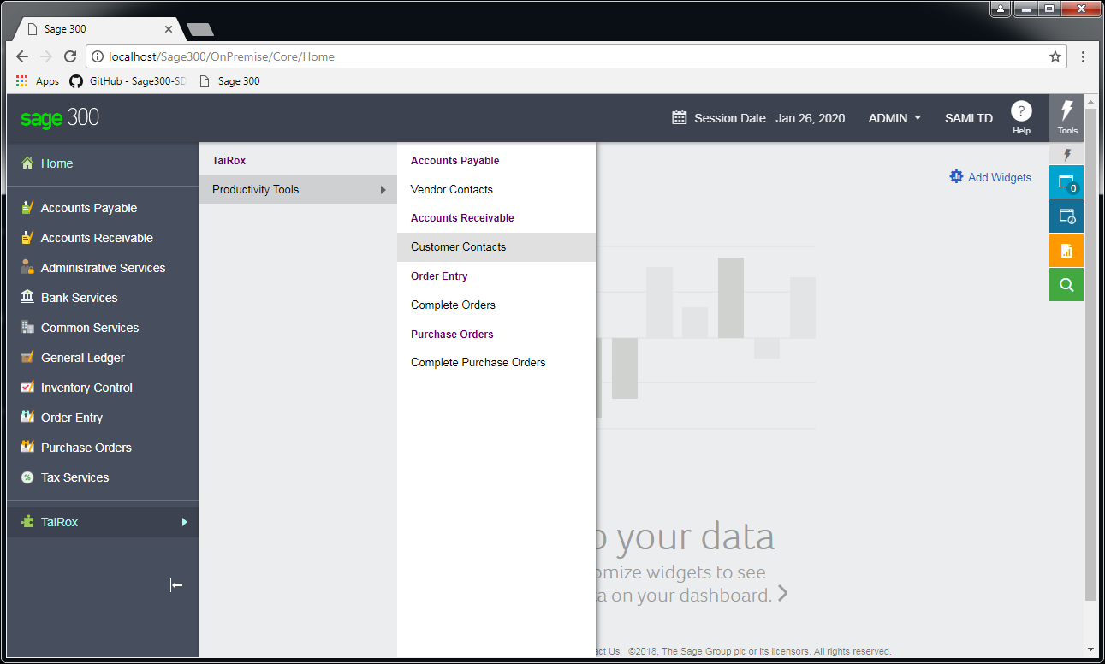
300cloud?

Slide 3
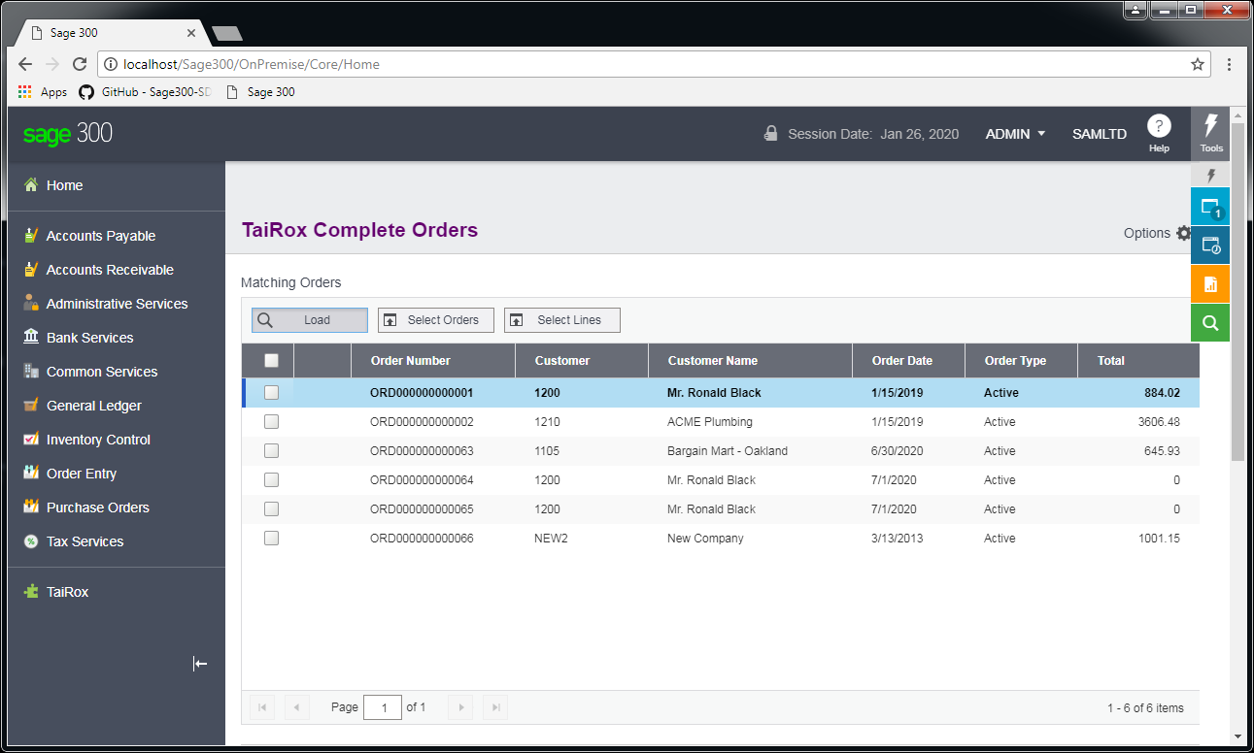
300cloud?

Slide 4
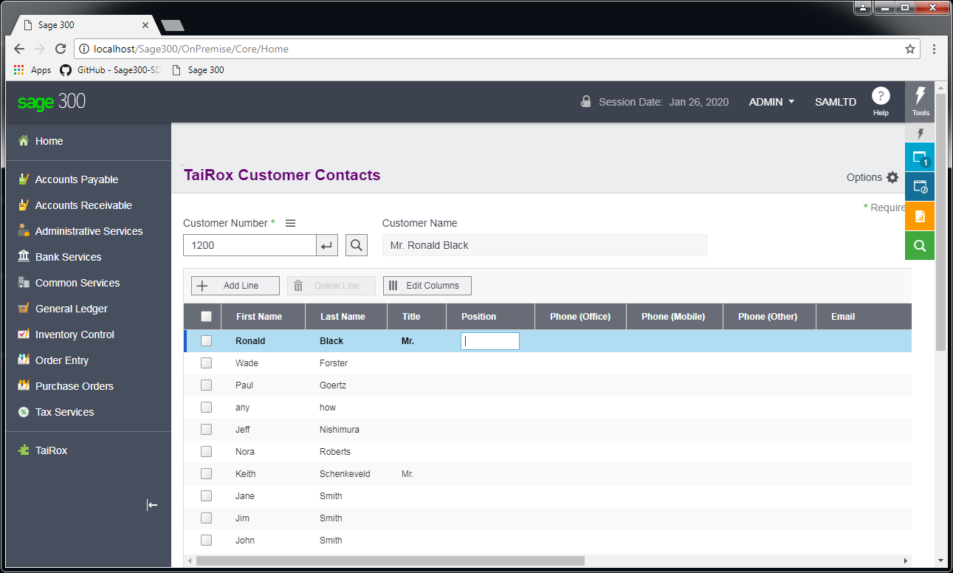
300cloud?

Slide 5
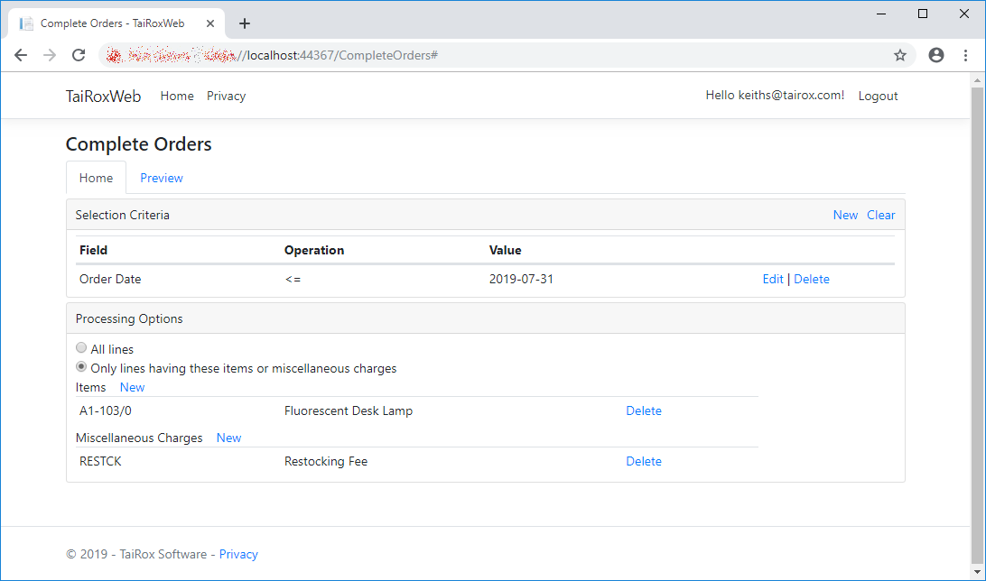
300cloud?

Slide 6
Names of TPT Programs
Extended
  Means the program “takes over” a Sage 300 UI
  Compatible with Orchid Extender
Complete, Delete, Update, Ship, Invoice, Apply, etc.
  Means the program performs hundreds of operations
Inquiry, Status
  Means improved visibility into data

Slide 7
49 Tools
Extended G/L Accounts
Extended G/L Segment Codes
Extended G/L Account Groups
Extended Fiscal Calendar
Extended Create New Year
Extended Customers
Extended Customer Inquiry
Extended Ship-To Location(s)
Extended A/R Receipt Entry
Extended Vendors
Extended Remit-To Location(s)
Ext. Create A/P Payment Batch
Extended Inventory Items
Extended Customer Details
Extended Vendor Details
Extended Manufacturers’ Items
Extended I/C Segment Codes
Extended Item Pricing
Extended Locations
Extended PO Entry
Extended PO Receipt Entry
Extended PO Invoice Entry
Extended Order Entry
Extended Shipment Entry
Extended Ship-Via Codes
Complete Orders
Complete Purchase Orders
Complete Zero Receipts
Delete Orders
Delete Quotes
Delete Purchase Orders
Delete Items
Delete BOMs
Ship Orders
Invoice Shipments
Update Orders
Update Shipments
Update Purchase Orders
Apply Documents
Mass Billing
Stock Reorder
Mail Merge
User Management
Accounting Status
Vendor Inquiry
Vendor Document Inquiry
Sales History Inquiry
Menu Options
Fix Item Valuation Errors
Set Recurring Dates
Sync Timecards

Slide 8
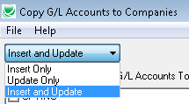
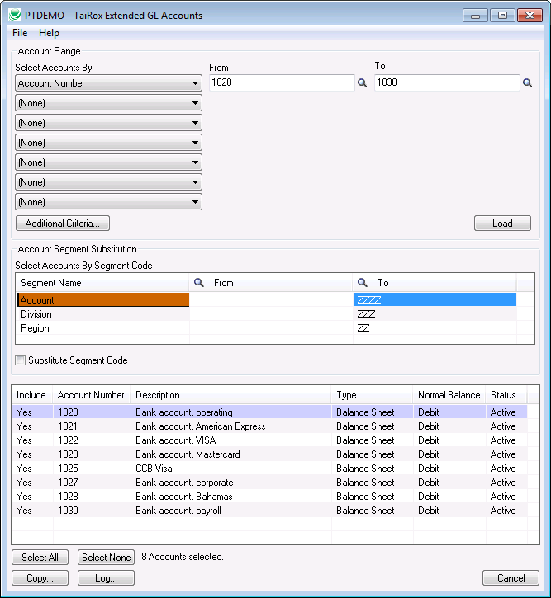
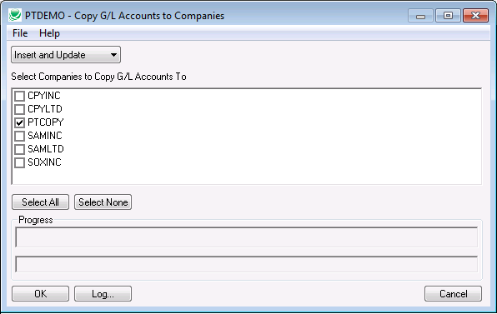
Extended G/L Accounts – Details

Slide 9
Extended G/L Accounts – Notes
Uses Sage 300 objects for source and destination copying
  Requires 2 Lanpaks on older versions of Sage 300
No operation will copy balances
Operations
  Insert Only – safe
  Update Account Description Only – safe
  Full Update – merges optional fields, will change account type, etc.

Slide 10
Extended Functionality Copying
Extended G/L Accounts
Extended G/L Segment Codes
Extended G/L Accounts Groups
Extended Fiscal Calendar
Extended Create New Year
Extended Customers*
Extended Vendors*
Extended Inventory Items*
Extended I/C Segment Codes
Extended Item Pricing
Extended Locations
Extended Ship-Via Codes

Slide 11
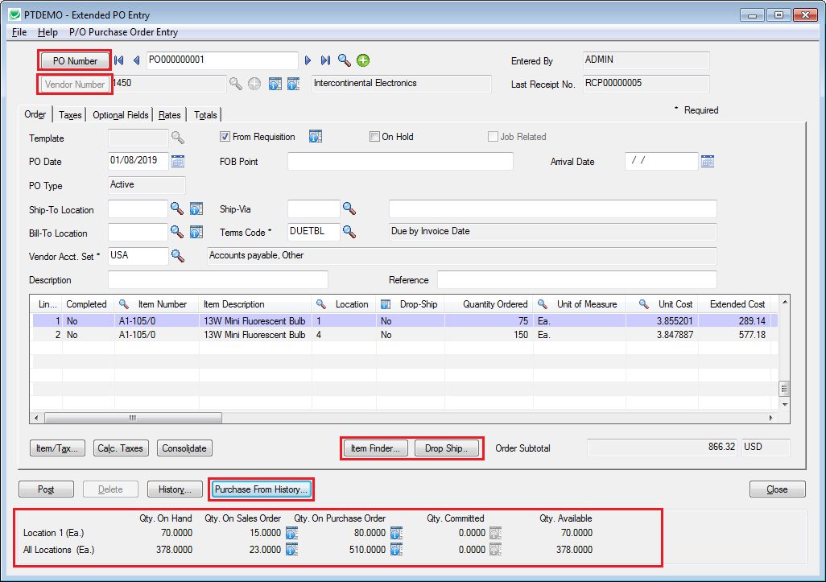
Extended PO Entry

Slide 12
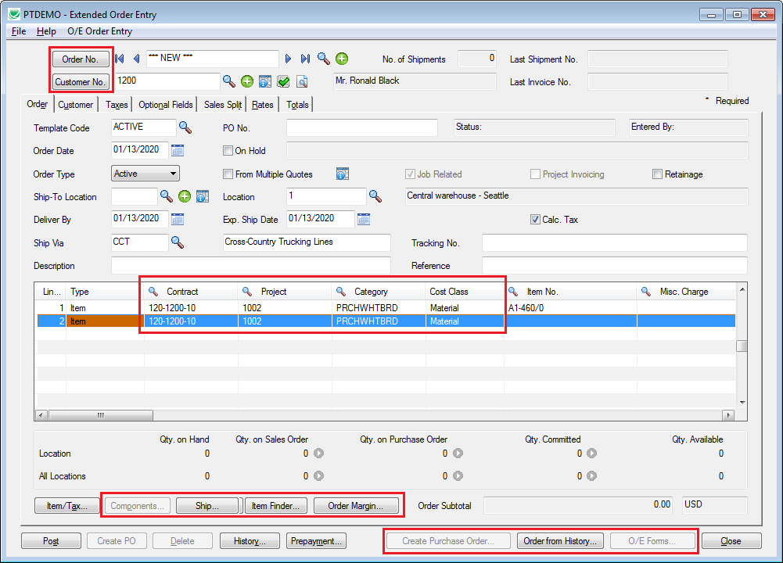
Extended Order Entry

Slide 13
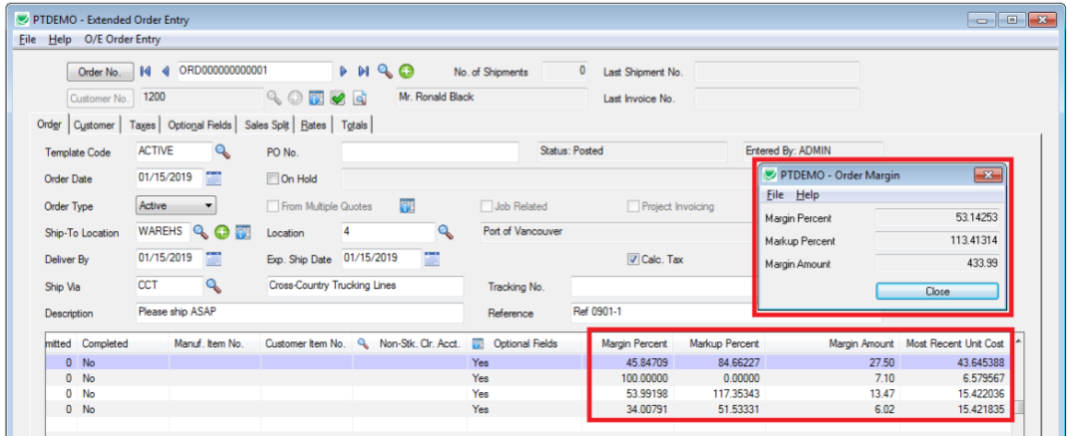
Extended Order Entry

Slide 14
Hundreds of Operations
Simple Clean-Up
Complete Orders
Complete Purchase Orders
Complete Zero Receipts
Delete Orders
Delete Quotes
Delete Purchase Orders
Delete Items
The Reason to Buy
Update Orders
Update Shipments
Update Purchase Orders
Ship Orders
Invoice Shipments
Apply Documents
Mass Billing

Slide 15
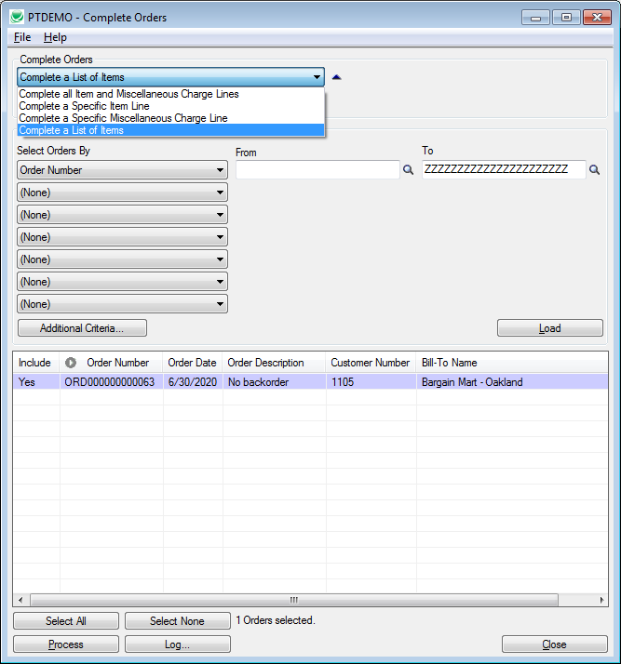
Clean Up – Complete Orders

Slide 16
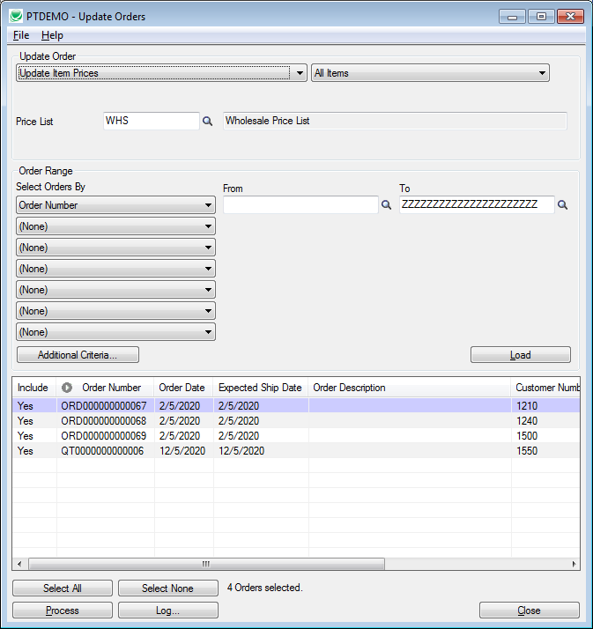
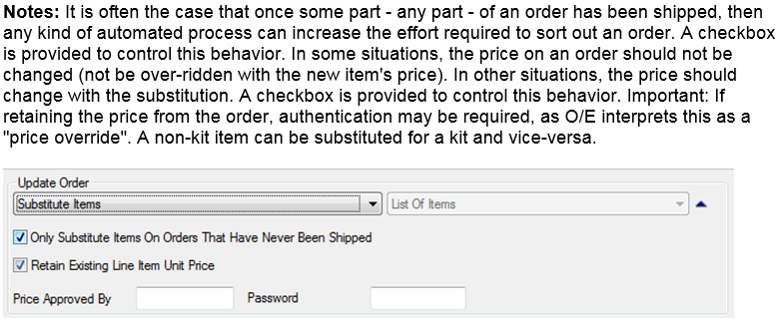
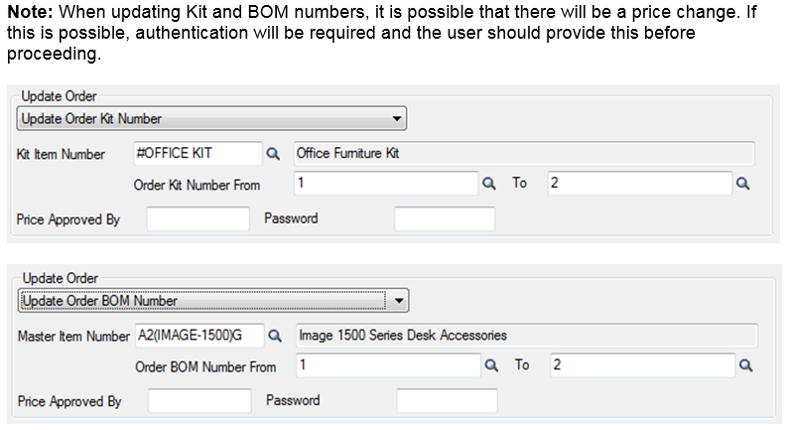
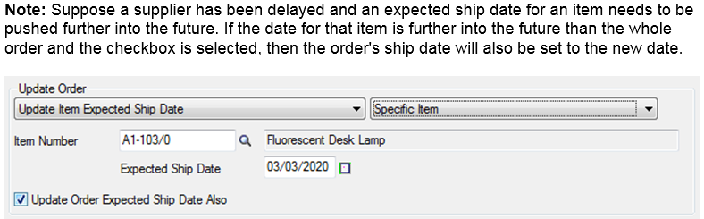
Catch Up – Update Orders

Slide 17
Update Orders – Notes
Operations:
  Update a kit number
  Update a BOM number
  Update an expected ship date
  Update item prices
  Substitute one item for another
  Change on-hold status for a customer
  Change addresses & recalculate taxes
Apply to:
  All items
  A specific item
  A specified list of items
Options:
  Price approval overrides
  Update header expected ship date
  Retain existing line item price
  Don’t mess with partially shipped orders

Slide 18
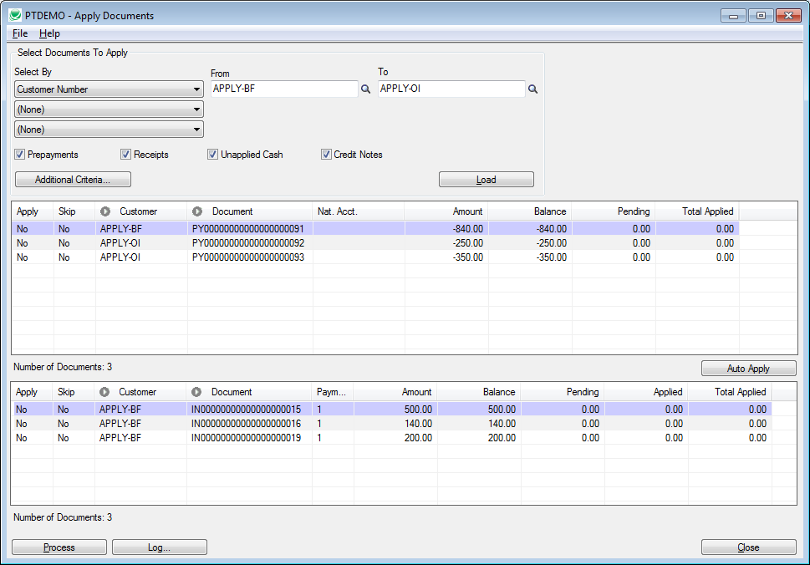
Matching Payments – Apply Documents

Slide 19
Inquiry
Accounting Status
Vendor Inquiry
Vendor Document Inquiry
Sales History Inquiry

Slide 20
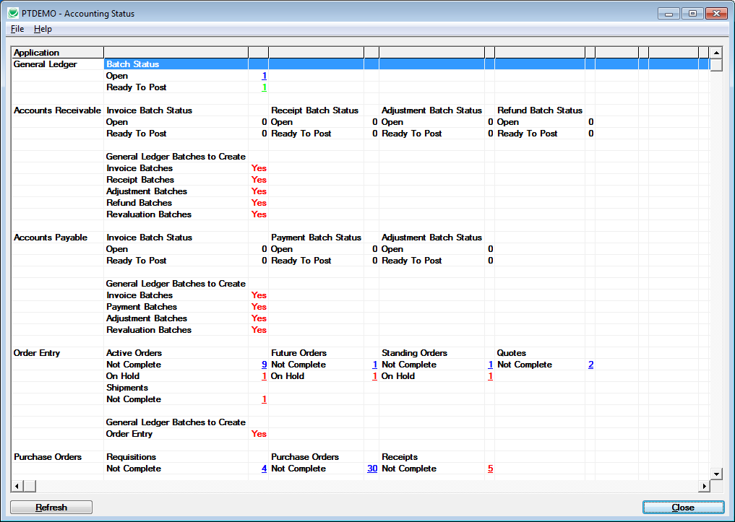
Accounting Status

Slide 21
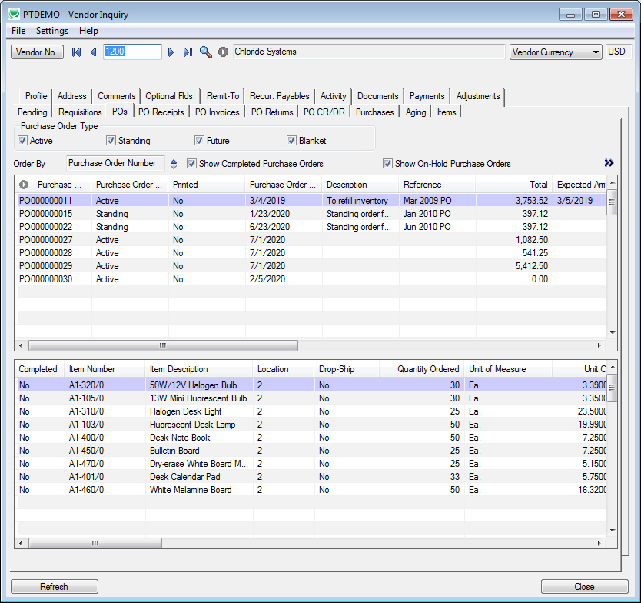
Vendor Inquiry

Slide 22
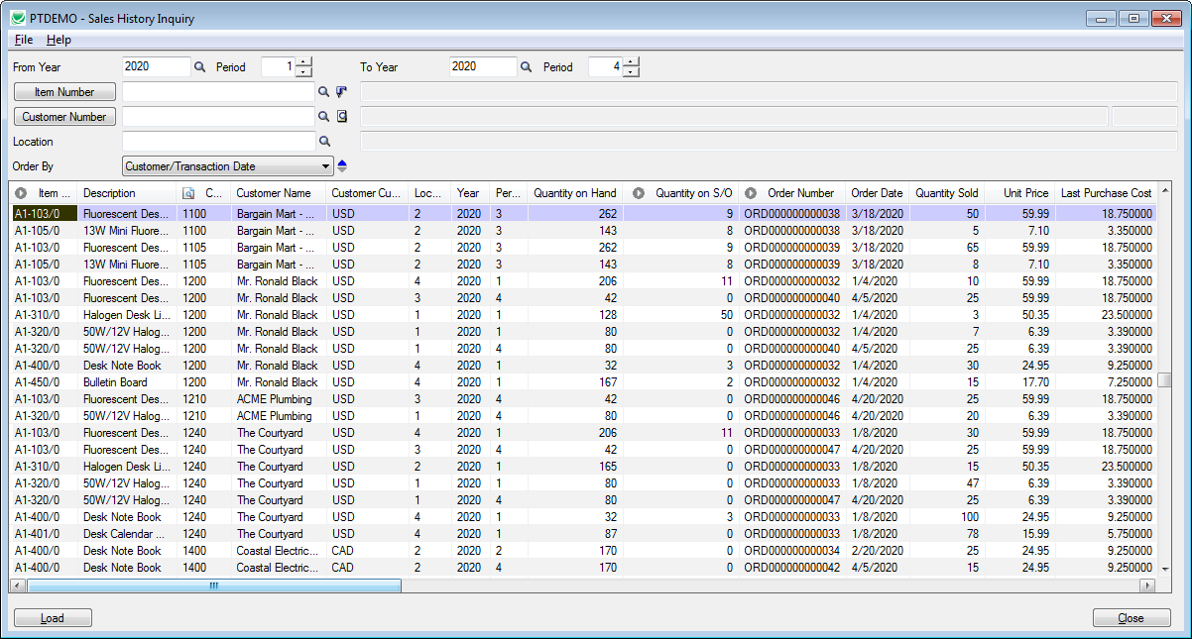
Sales History Inquiry

Slide 23
49 Tools
Extended G/L Accounts
Extended G/L Segment Codes
Extended G/L Account Groups
Extended Fiscal Calendar
Extended Create New Year
Extended Customers
Extended Customer Inquiry
Extended Ship-To Location(s)
Extended A/R Receipt Entry
Extended Vendors
Extended Remit-To Location(s)
Ext. Create A/P Payment Batch
Extended Inventory Items
Extended Customer Details
Extended Vendor Details
Extended Manufacturers’ Items
Extended I/C Segment Codes
Extended Item Pricing
Extended Locations
Extended PO Entry
Extended PO Receipt Entry
Extended PO Invoice Entry
Extended Order Entry
Extended Shipment Entry
Extended Ship-Via Codes
Complete Orders
Complete Purchase Orders
Complete Zero Receipts
Delete Orders
Delete Quotes
Delete Purchase Orders
Delete Items
Delete BOMs
Ship Orders
Invoice Shipments
Update Orders
Update Shipments
Update Purchase Orders
Apply Documents
Mass Billing
Stock Reorder
Mail Merge
User Management
Accounting Status
Vendor Inquiry
Vendor Document Inquiry
Sales History Inquiry
Menu Options
Fix Item Valuation Errors
Set Recurring Dates
Sync Timecards

Slide 24
Hiding Tools – With or Without Security

Slide 25
Learn More About
Productivity Tools PDF Brochure with Embedded Videos
http://www.tairox.com

