Slide 1

TaiRox Training
Don Thomson

Slide 2
Training Agenda
Announcements
TaiRox Web Site Resources
TaiRox Products, What's New 1
(bio break)
The Future of Sage 300
TaiRox Products, What's New 2

Slide 3
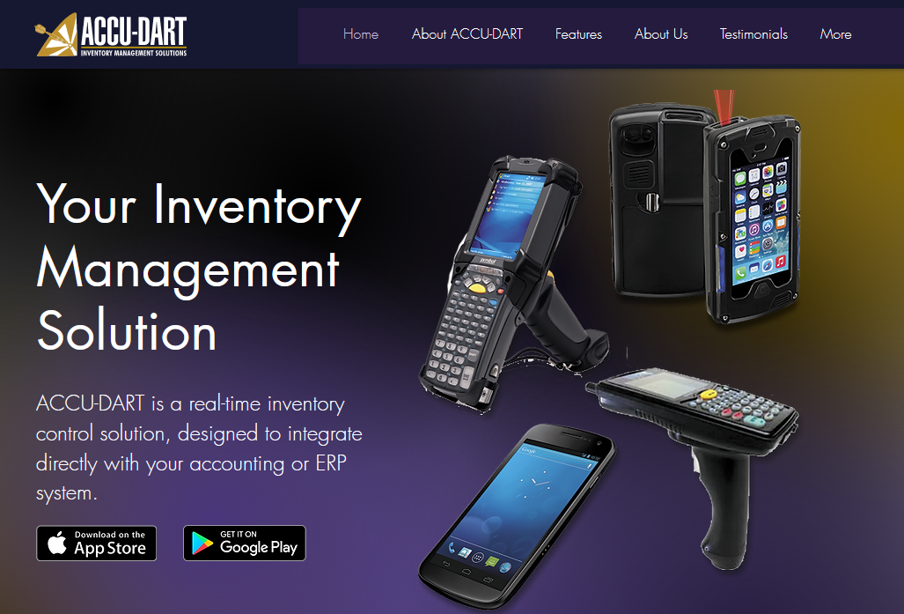
ACCU-DART Announcement
Executive Concepts Inc. and TaiRox Software Inc. have entered into an agreement related to the improvement, support, maintenance and customizations for the integration of Sage 300 with ACCU-DART: a real-time inventory solution.

Slide 4

Rejuvenate

Slide 5
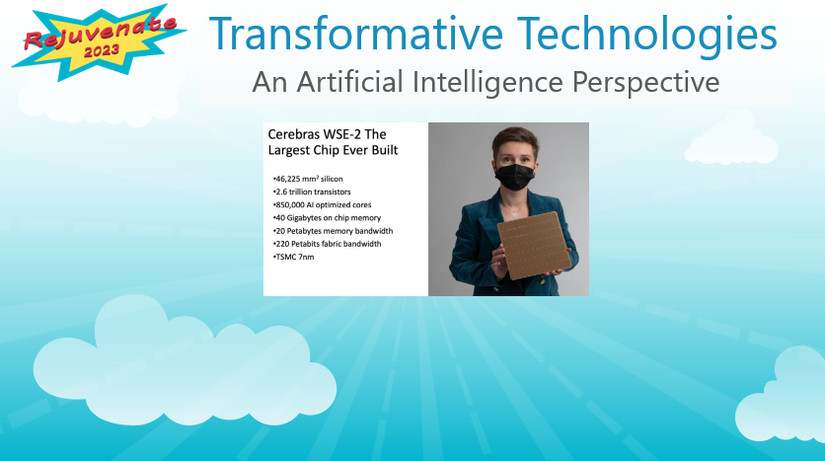
Rejuvenate

Slide 6
TaiRox Products, What's New 1

Slide 7

The Future of Sage 300

Slide 8
Accounting Software Evolution
An Accounting Package Finds a Niche
Existing Customers Grow
More Features, More Options are Added
Lo-Mid-Market: More Integration with External Systems
Hi-Mid-Market: Automation

Slide 9
Larger Distribution Companies
Warehouses
Third-Party Manufacturers (TPM)
Third-Party Logistics (3PL)
Automation

Slide 10
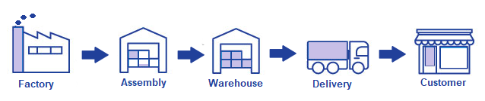
Larger Distribution Companies
Third Party or Owned, Often a Mixture

Slide 11
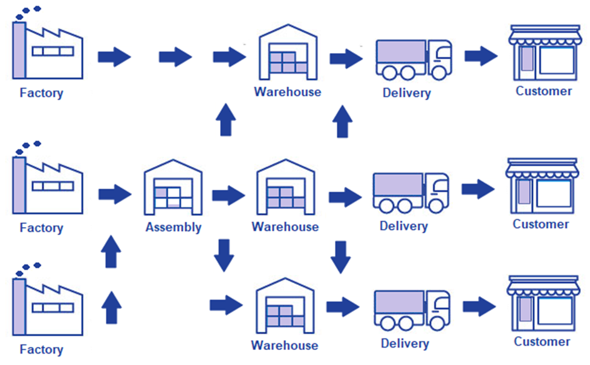
Larger Distribution Companies

Slide 12
Meat Distributor
Sage 300 I/C item quantity is pounds
  All pricing is by-the-pound
Meat is purchased and sold in lotted boxes
Purchase orders are created with weight estimates
  10 boxes of beef steaks weighing approximately 55 pounds each
Meat from lots is sold before it arrives (O/E order)
When boxes arrive, ACCU-DART scans lots
  Estimated weights are changed to actual weights
Meat is shipped in unopened boxes, scanned by ACCU-DART

Slide 13
Pet Food Distributor
Client sends empty bags to TPM on consignment
The TPM periodically creates a batch of pet food
  When a batch is created a number of bags are filled.
When the client takes orders they need to know how many bags are filled.
The TPM needs to know projected future quantities so they can plan batch creation.
Canned goods and POS materials are made elsewhere and sent to the TPM, who is also a 3PL.
The client has 3 Sage 300 Companies
  Canadian, USA and TPM-Mirror

Slide 14
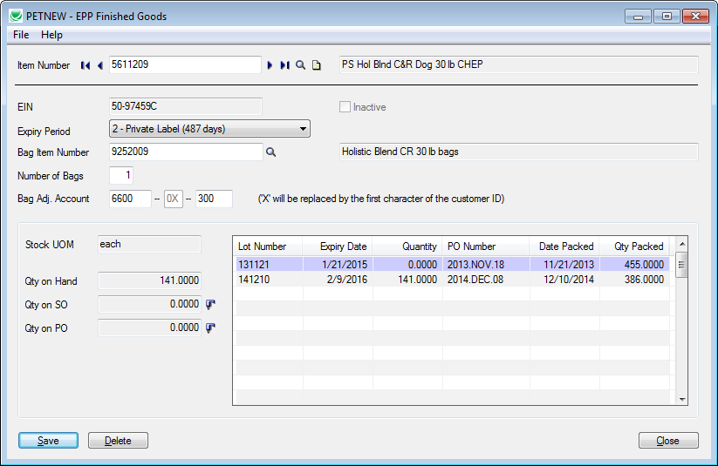
Pet Food Distributor

Slide 15
Solar Street Lamp Distributor
Client has multiple TPMs in China and USA
Street lamp structures are sent to customers
  Structures are erected before electronics are installed
Client has multiple 3PLs who ship electronics to customers
Electronics are dependent on GPS location
  Sunlight hour variation is different at different latitudes.
Multiple systems update using Microsoft Message Queuing

Slide 16
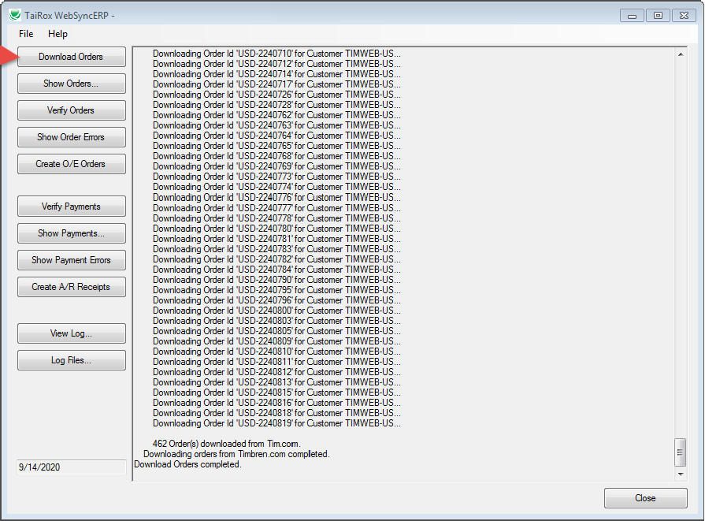
WebSyncERP
80% product
20% customization

Slide 17
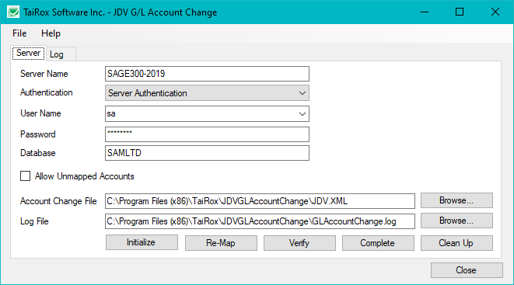
G/L Account Code Change
80% product
20% customization

Slide 18


Stability vs. Innovation

Slide 19
TaiRox Products, What's New 2

Slide 20
Training Agenda
Announcements
TaiRox Web Site Resources
TaiRox Products, What's New 1
(bio break)
The Future of Sage 300
TaiRox Products, What's New 2

