Slide 1

What's New at TaiRox 2023
Don Thomson, CEO

Slide 2
What’s New
TaiRox Website Resources
Productivity Tools Enterprise
SOX Check Approval Enterprise
TaiRox Collections
Fast Products
Diagnosing A Sage 300 Environment

Slide 3
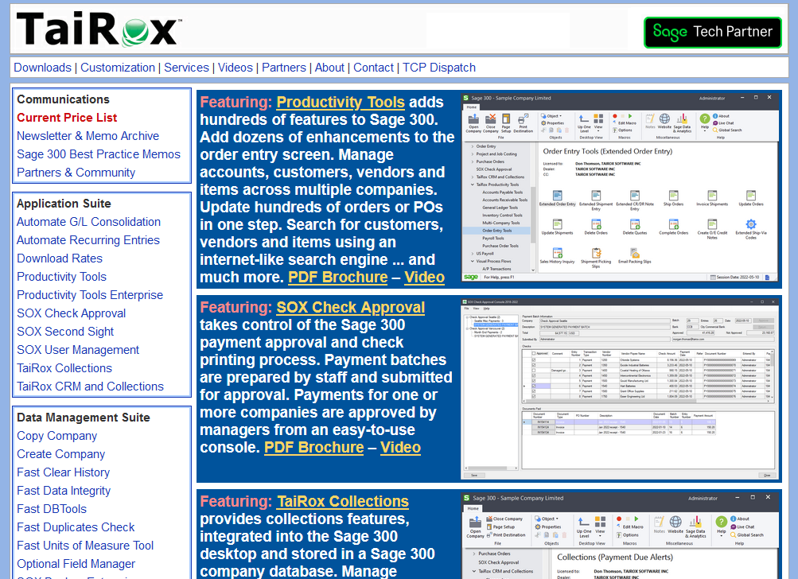
TaiRox Website
Up-to-Date
  Price List
  PDF Brochures
  Videos
  Memos
  Newsletters
  Downloads
  Release Notes
  Install Check

Slide 4
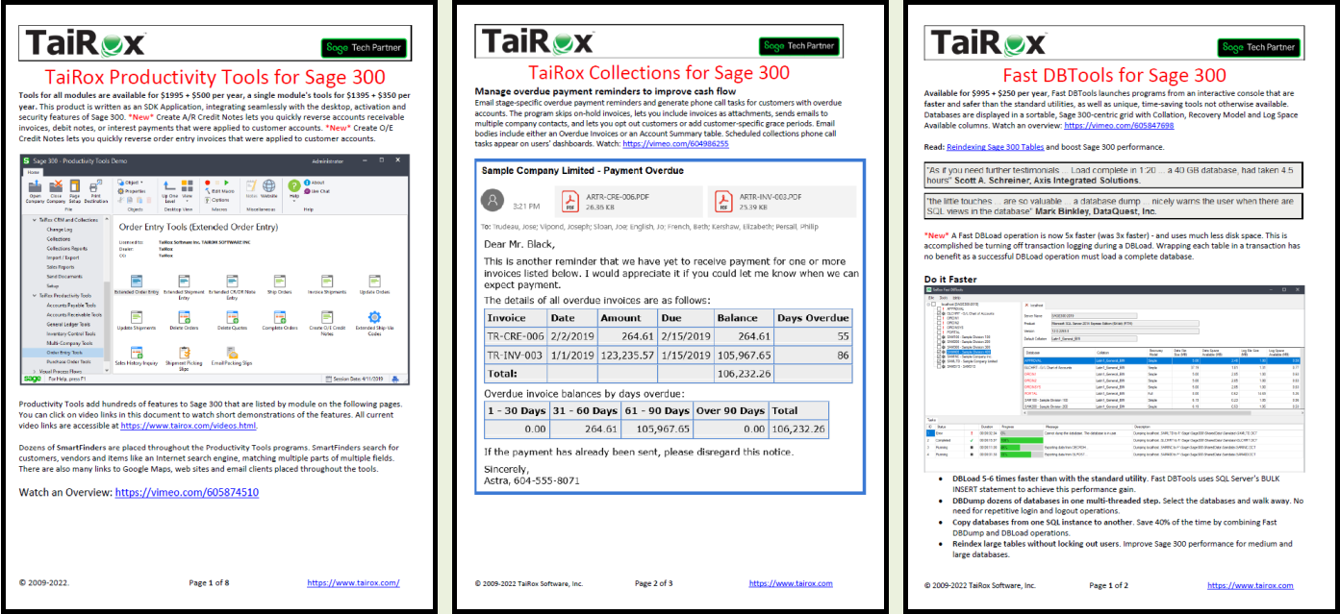
PDF Brochures with Embedded Videos

Slide 5
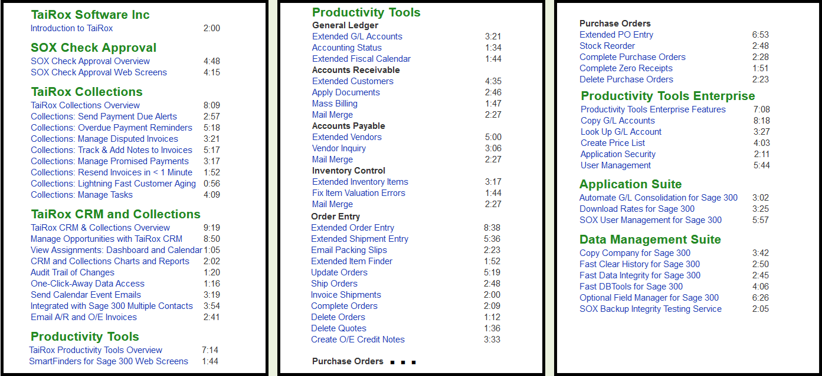
Videos Page

Slide 6
Memos: Sage 300 Technical Details

Slide 7
Names of 50+ Productivity Tools Programs
Extended
  The program “takes over” a Sage 300 UI
Complete, Delete, Update, Ship, Invoice, Apply, etc.
  The program performs hundreds of operations
Inquiry, Status, Look Up
  The program provides improved visibility into data

Slide 8
Productivity Tools – New Features
Multiple Programs
  Improved French translations
  Remember login user and passwords
  Show Quantity Totals
  Show Prepayments
Update Purchase Orders - Substitute Items
Update Orders - Update Ship Via, Reference, Item Location

Slide 9
Productivity Tools – New Programs
  Extended O/E Invoice Entry – show prepayments
  Create O/E Credit Notes - create for multiple O/E invoices
  Create A/R Credit Notes - create multiple A/R invoices
  Email Packing Slips - send to customer, ship-to, or entered email
  Copy G/L Accounts - manage multi-company General Ledgers
  Look Up G/L Account - for huge ledgers with many segments
  Application Security - required security permissions to show icon
  Create Price List - create a spreadsheet for complex customer prices

Slide 10
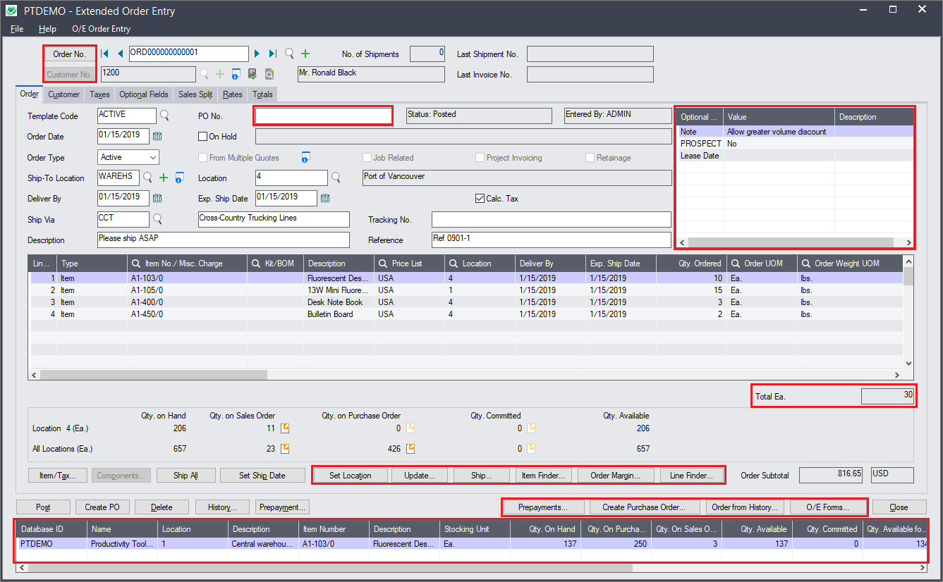
Productivity Tools – Extended Order Entry

Slide 11
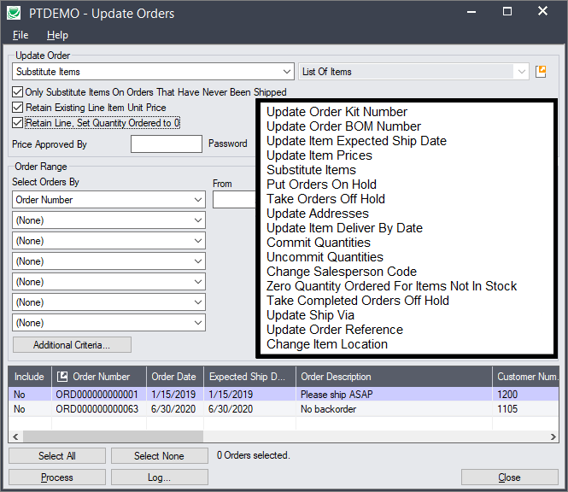
Productivity Tools – Update Orders

Slide 12
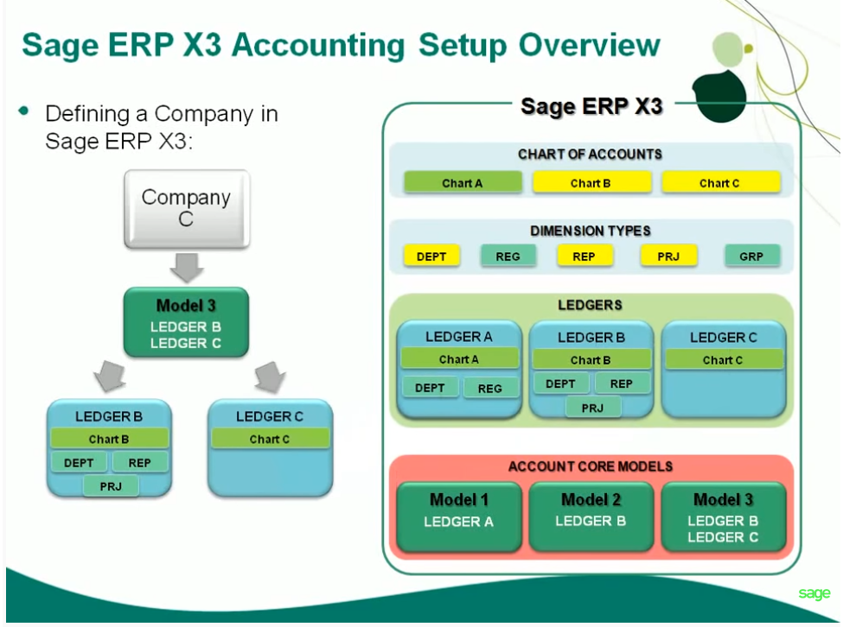
Multi-Company Ledgers
Notes:
Products like Oracle Financials and Sage X3 define these rules using various models like the one shown here.

Slide 13
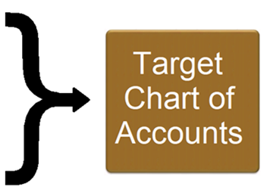
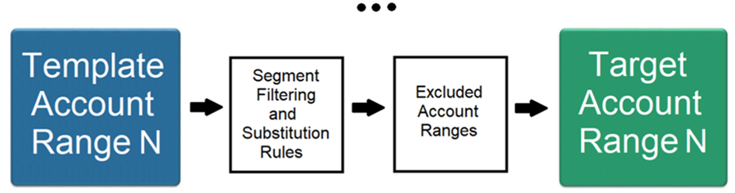
Productivity Tools Enterprise
Notes:
In a template company, the rules are kept for every target company.
click
A rule set starts with a range of accounts. For that range, there can be any number of segment filtering and substitution rules. As well, accounts can be excluded – specified as any number of excluded account ranges. That is one rule set and it may be all you need. My demonstrations have only rule set.
click
However, any number of rule sets can be defined for each target company
click
producing in the end the target company’s complete chart of accounts.

Slide 14
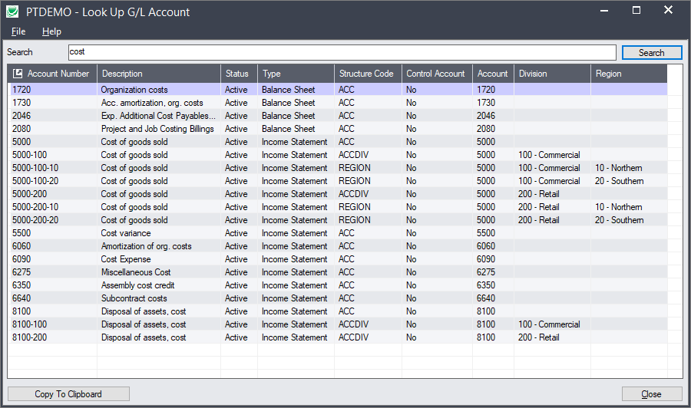
PT Enterprise – Look Up G/L Account
Notes:
A setup and a copying program provide the new functionality. A subscription to Copy Company is included.
click
Unlike many sub-enterprise products, there are no license limitations for users or companies.

Slide 15
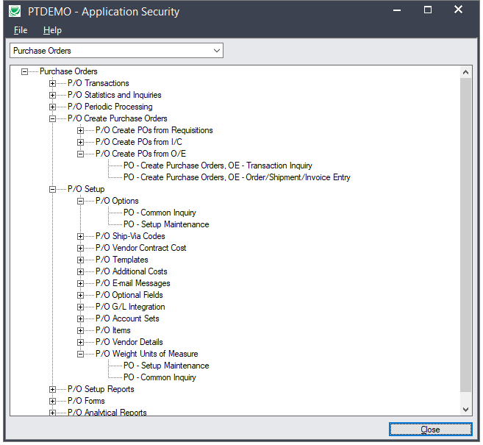
PT Enterprise – Application Security
Notes:
A setup and a copying program provide the new functionality. A subscription to Copy Company is included.
click
Unlike many sub-enterprise products, there are no license limitations for users or companies.

Slide 16
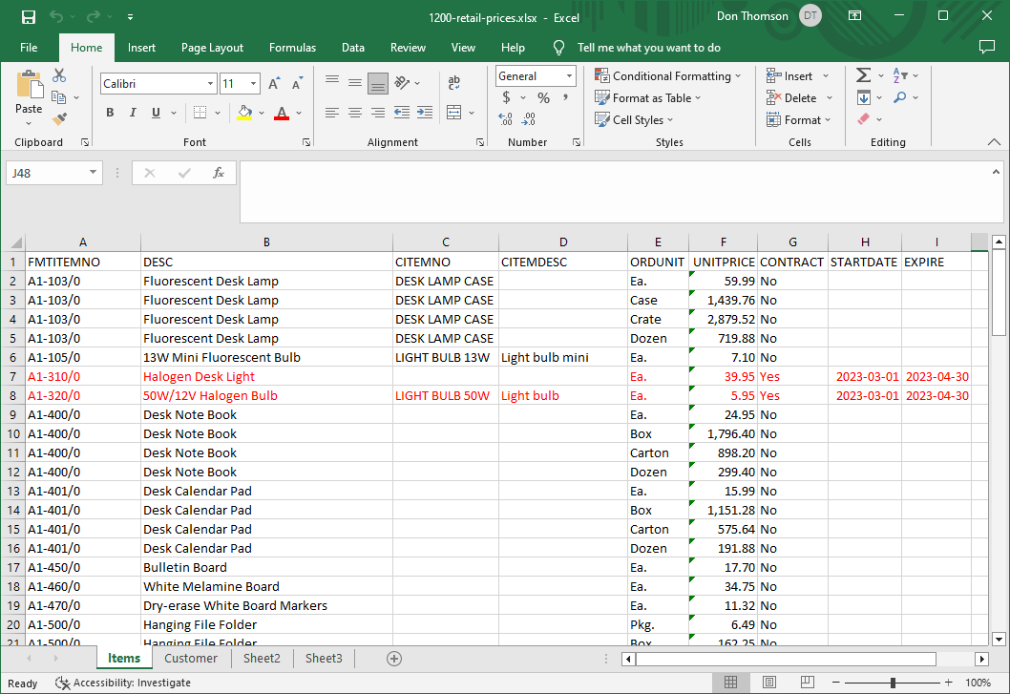
PT Enterprise – Create Price List
Notes:
A setup and a copying program provide the new functionality. A subscription to Copy Company is included.
click
Unlike many sub-enterprise products, there are no license limitations for users or companies.

Slide 17
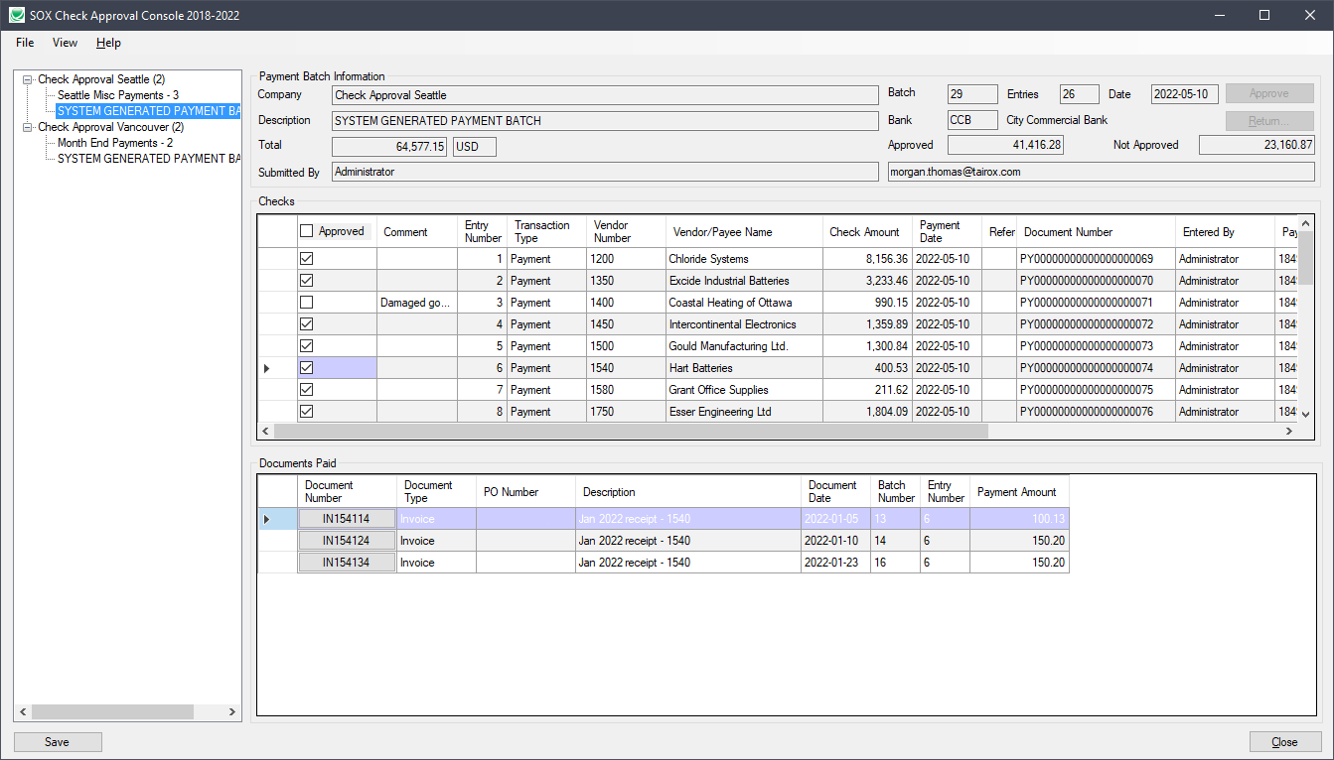
SOX Check Approval
4 Workflows
  Strict
  Basic
  Relaxed
  Simplified
Hybrid Workflows
Web Screens

Slide 18
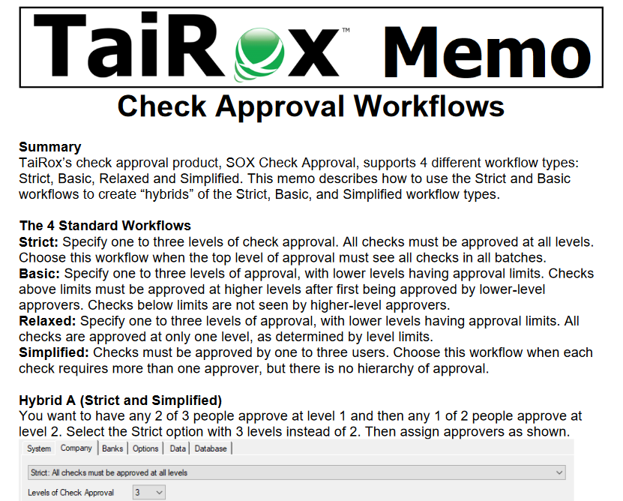
SOX Check Approval
Hybrid Workflows

Slide 19
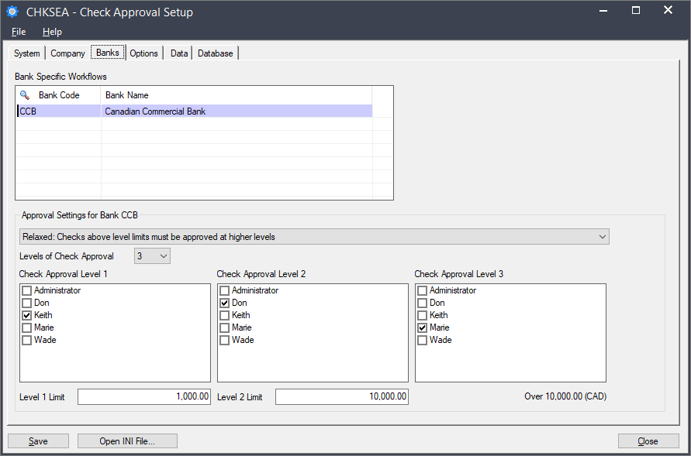
SOX Check Approval Enterprise
Workflows Per Bank

Slide 20
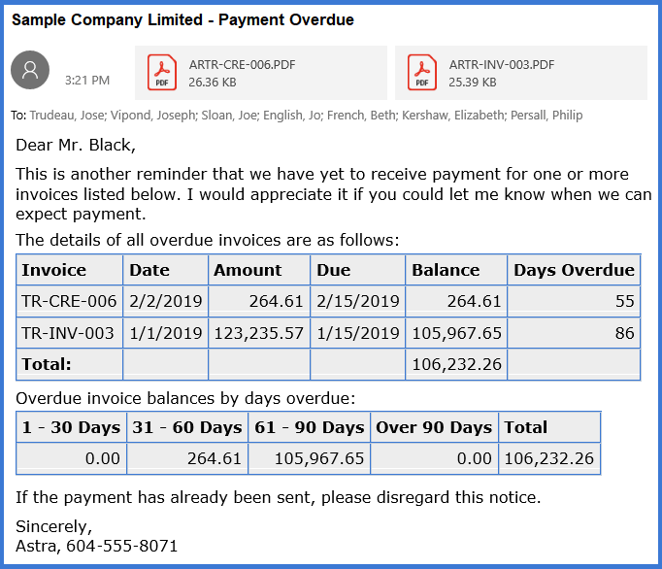
TaiRox Collections
Overdue Payment Reminders
  Aging Table Added
  Account Summary Option
  Phone Call Option
  Consolidation
  HTML Templates
  Service Manager Invoices
Payment Due Alerts

Slide 21
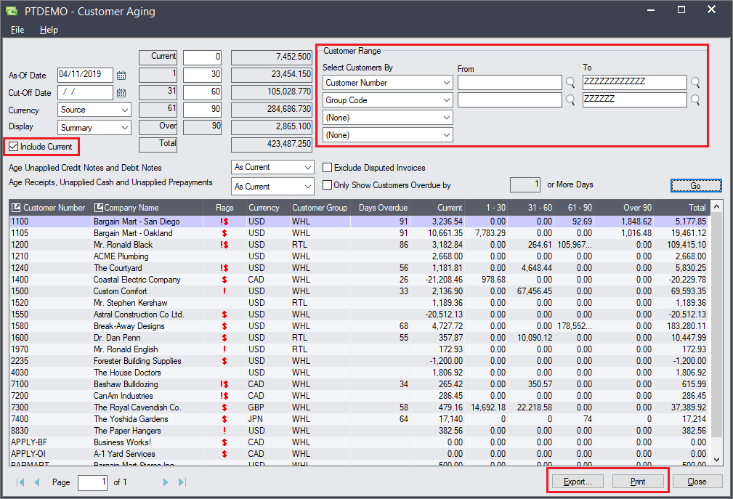
TaiRox Collections
Aged Trial Balance
  Filtering Options
  Export to Excel
  Print ATB
Calendar Display
Reports
  Promised Payments
  Disputed Invoices
  Change Log

Slide 22
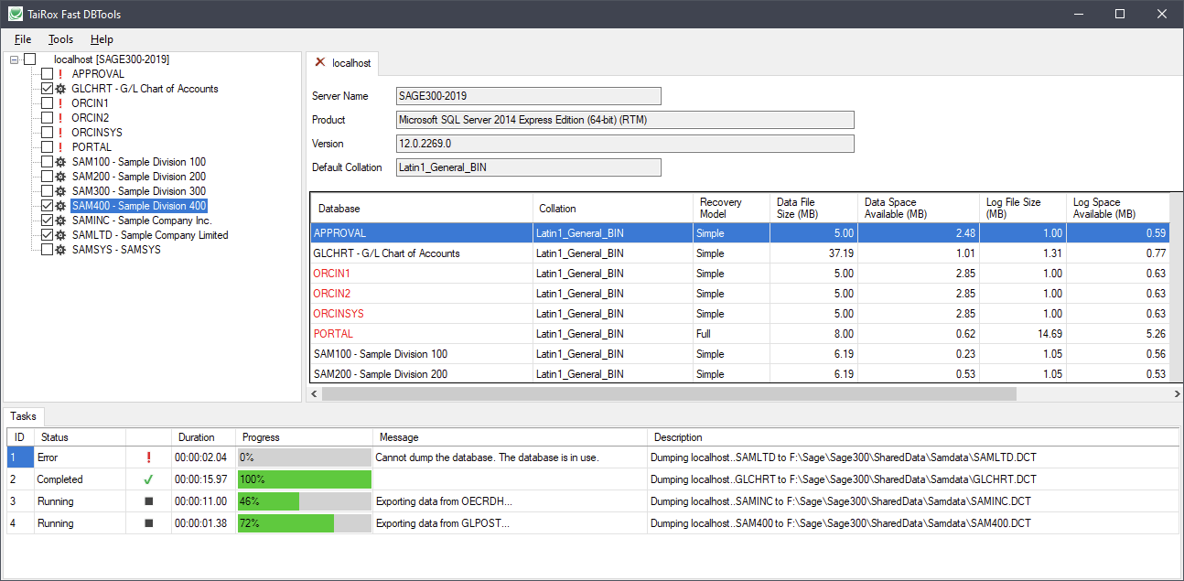
Fast DBTools
DBLoad
  Now 5x-6x faster
  (no transactions)
Passwords
Re-indexing

Slide 23
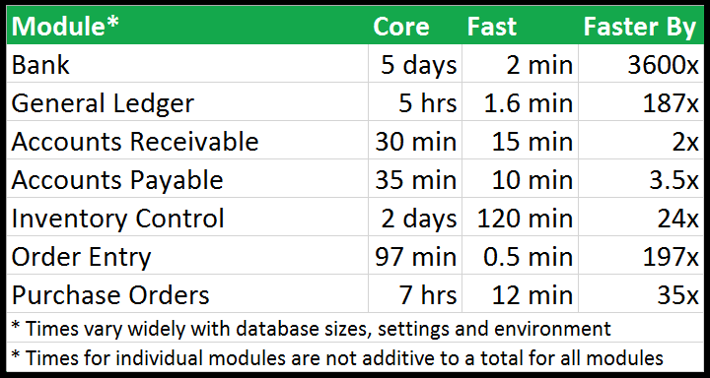
Fast Clear History – What’s New
Clears More
  AR/AP Tax Withholding
  AR/AP Deleted Batches
  Clears Collections & CRM
Options
  OE Use Transaction Date
    Instead of Completion Date
Passwords

Slide 24
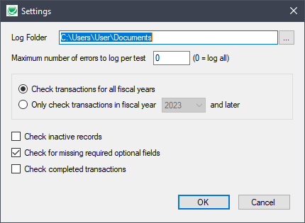
Fast Data Integrity – What’s New
Checks More
  Recent PJC Versions
  Productivity Tools Enterprise
  TaiRox Collections & CRM
Checks Less
  Inactive Records
  Completed Transactions
  Required Optional Fields
Passwords

Slide 25
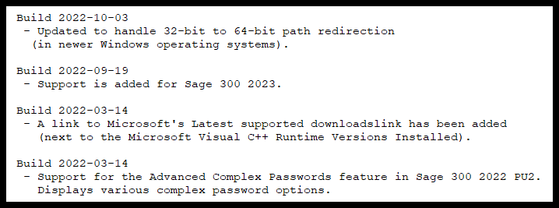
Support: What’s New in Install Check

Slide 26
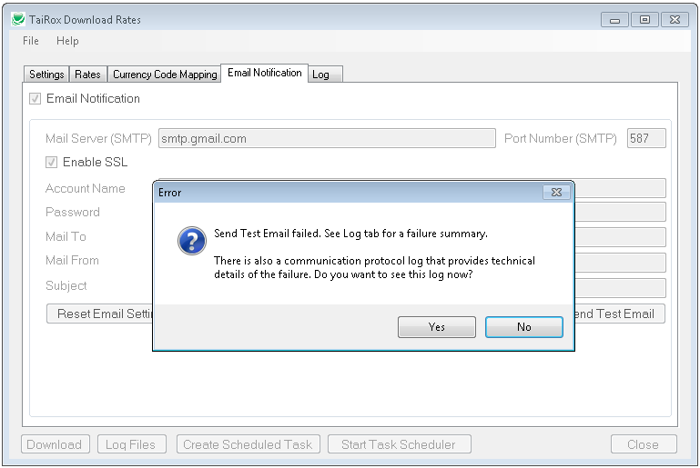
Support: Diagnosing Email Problems

Slide 27
What’s New
TaiRox Website Resources
Productivity Tools Enterprise
SOX Check Approval Enterprise
TaiRox Collections
Fast Products
Diagnosing A Sage 300 Environment

