Slide 1
TPAC Super Session: Add-On Products for Sage 300 TaiRox Copy Company

Slide 2
TaiRox Copy Company
Copy Company will copy an existing company's structure without copying transactional data, flawlessly performing many hours of manual manipulation with one push of a button.
Copy general ledger accounts, customers, vendors, inventory items, employees, multiple contacts, recurring entries and operational setup options.

Slide 3
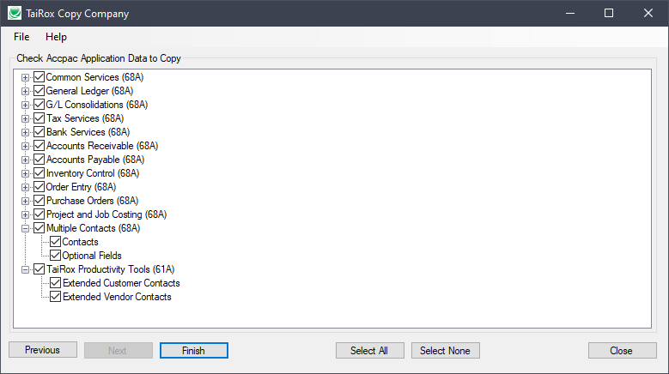
TaiRox Copy Company
https://vimeo.com/605843389

