Slide 2
Agenda
TaiRox CRM Review
What’s New
June 2018: cases, customer aging, notes
September 2018: single send invoices to multiple contacts
March 2019: bulk send invoices to multiple contacts
March 2019: notes Fields > 250 characters
TaiRox CRMc Update

Slide 3
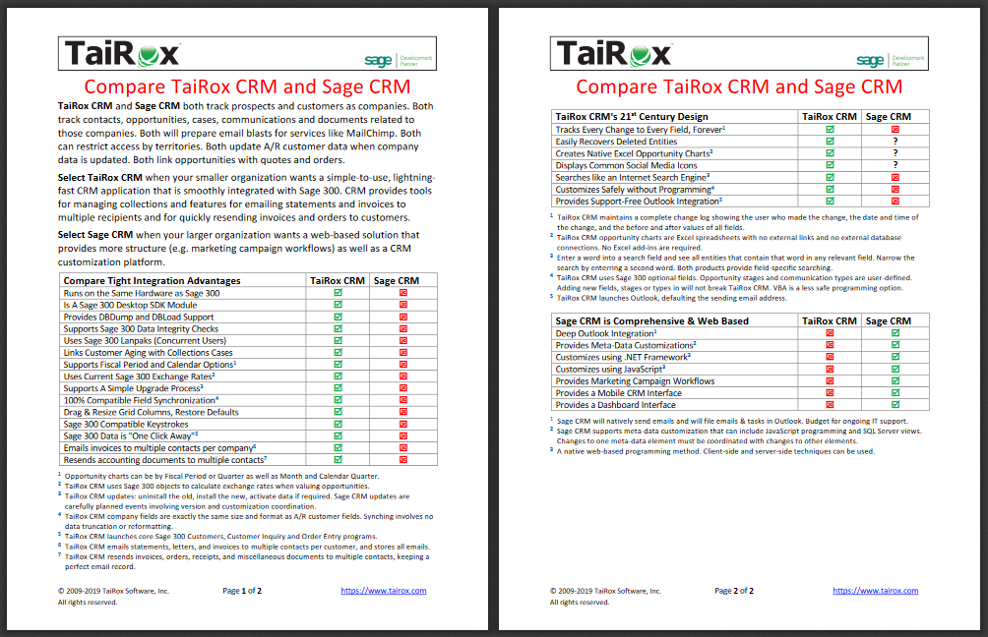
TaiRox CRM is …
Sage 300 Accounting Oriented CRM Functionality

Slide 4
TaiRox CRM is Sage 300 Oriented
Same Hardware
Same Desktop
Same Licensing Scheme: Lanpaks
Same Database Admin: DBDump & DBLoad
Same Customization Method: Optional Fields
Same Data Format & Sizes
Same Data Activation
Same Users & Permissions
Same Translations
Same Reporting Tools & Versions
Same Software Stack, Icons, Finders, etc.

Slide 5
TaiRox CRM Demonstration
Everything you want to see is one-click away
Operation is lightning fast for an SDK application
Searches like an internet search engine
Visible social media integration
Every change to every field for every entity is kept forever

Slide 6
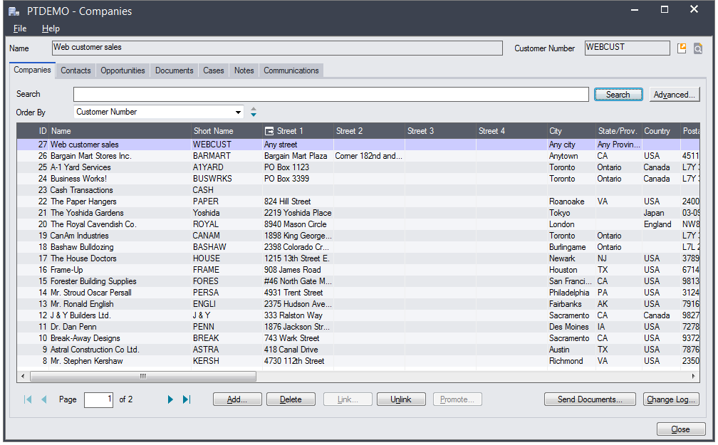
Companies

Slide 7
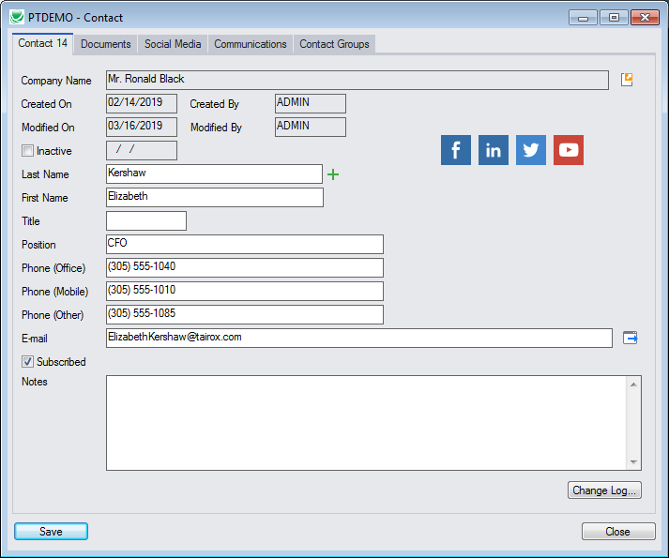
Contacts

Slide 8
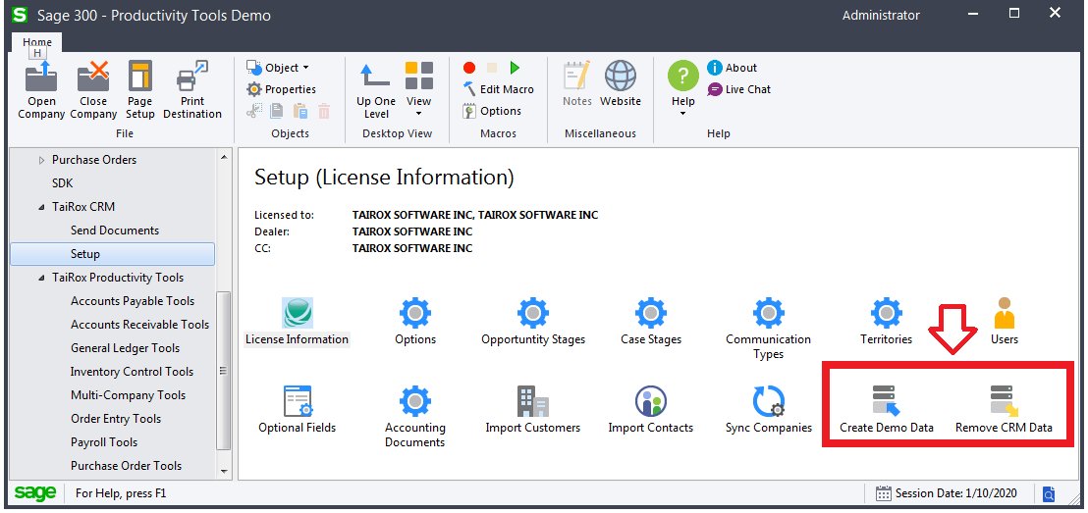
Easy to Demo, Easy to Evaluate

Slide 9
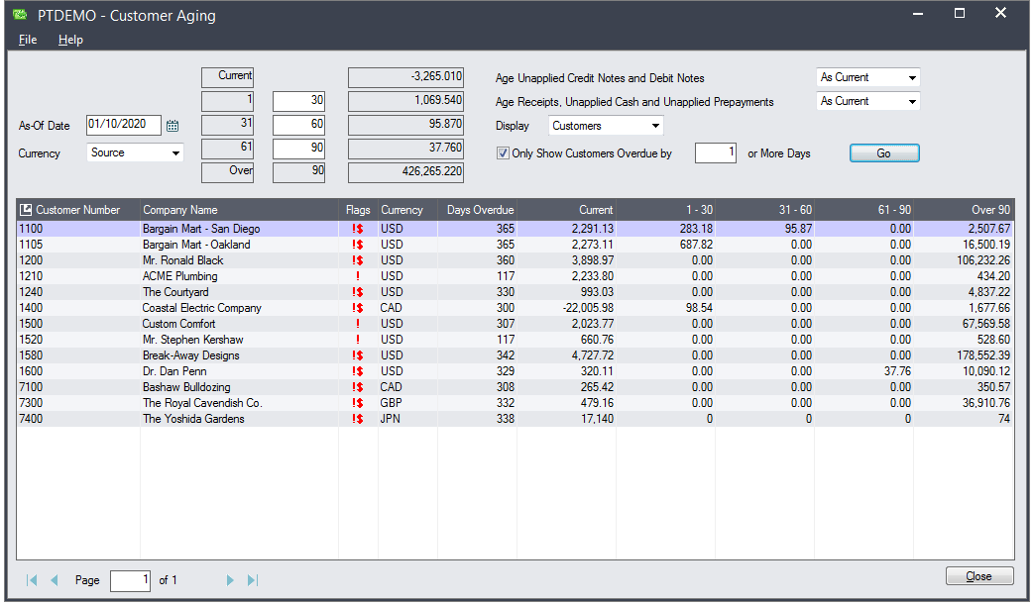
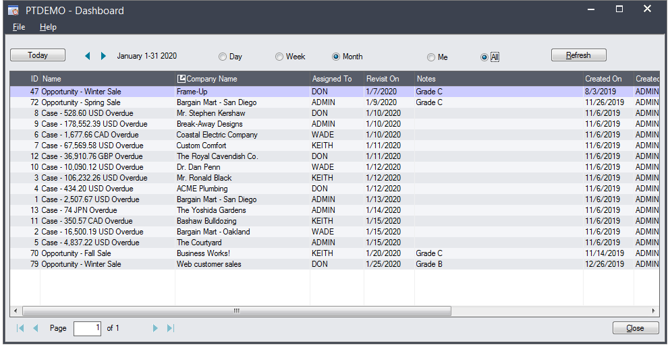
Customer Aging and Cases

Slide 10
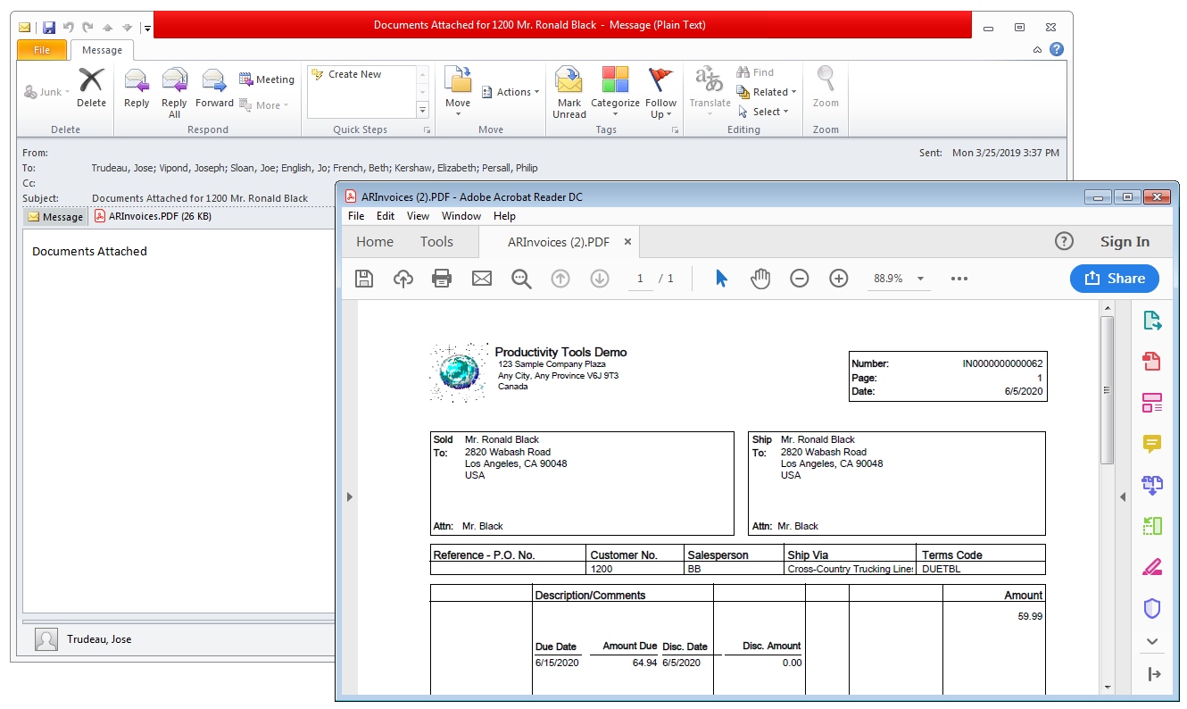
Send Documents to Multiple Contacts

Slide 11
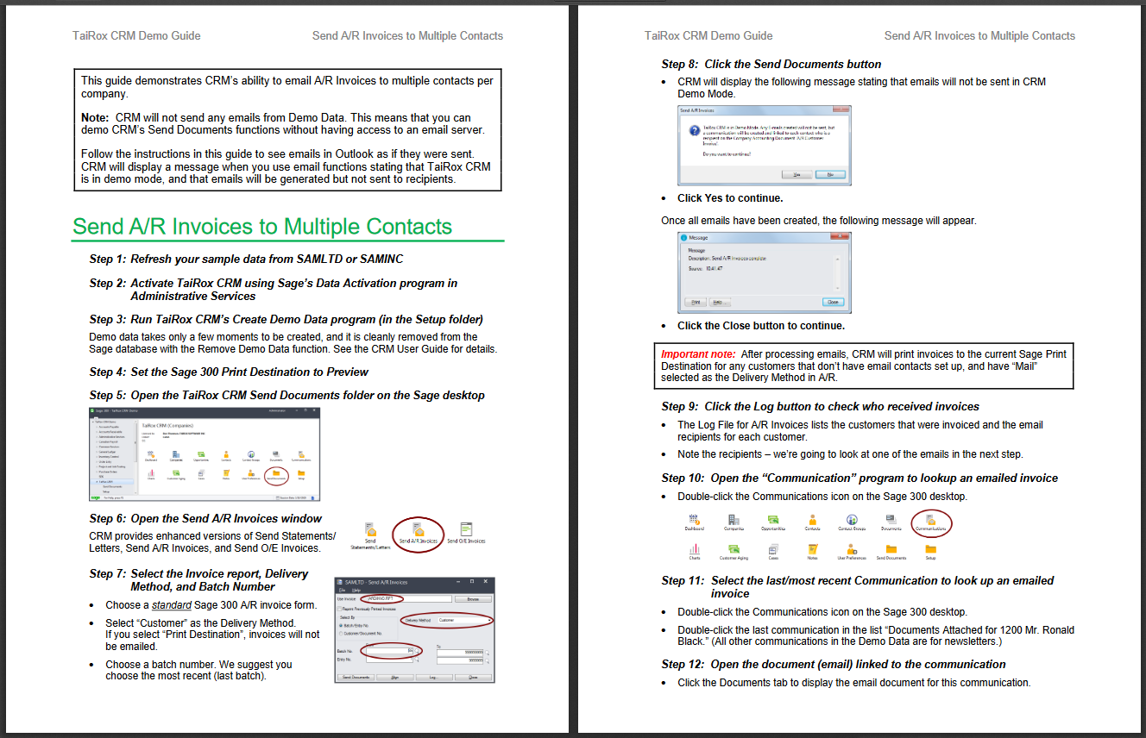
Demonstration Guide

Slide 12
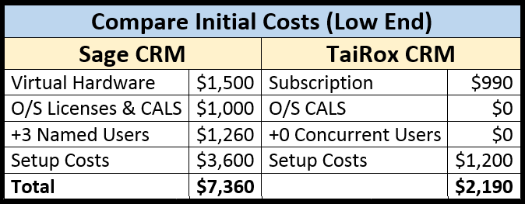
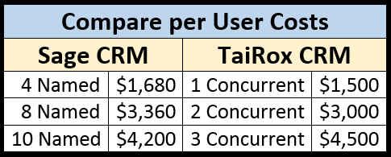
Compare $
Note: Volume discounts kick-in earlier with 1 licensing scheme

Slide 13
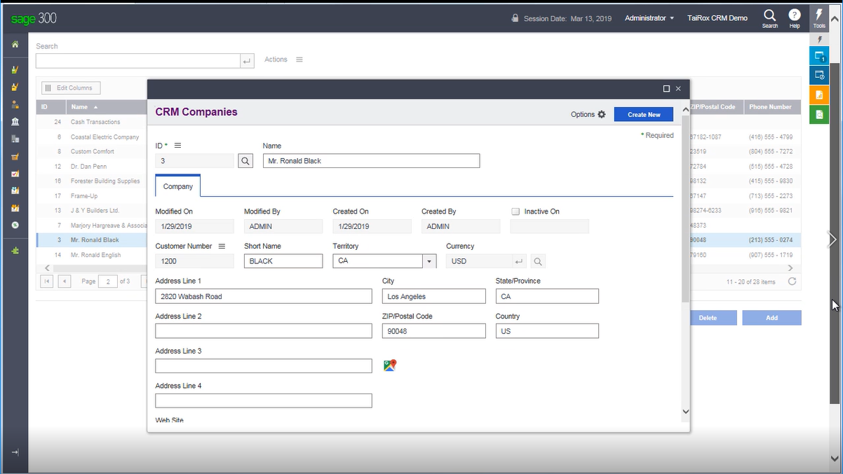
TaiRox CRMc

Slide 14
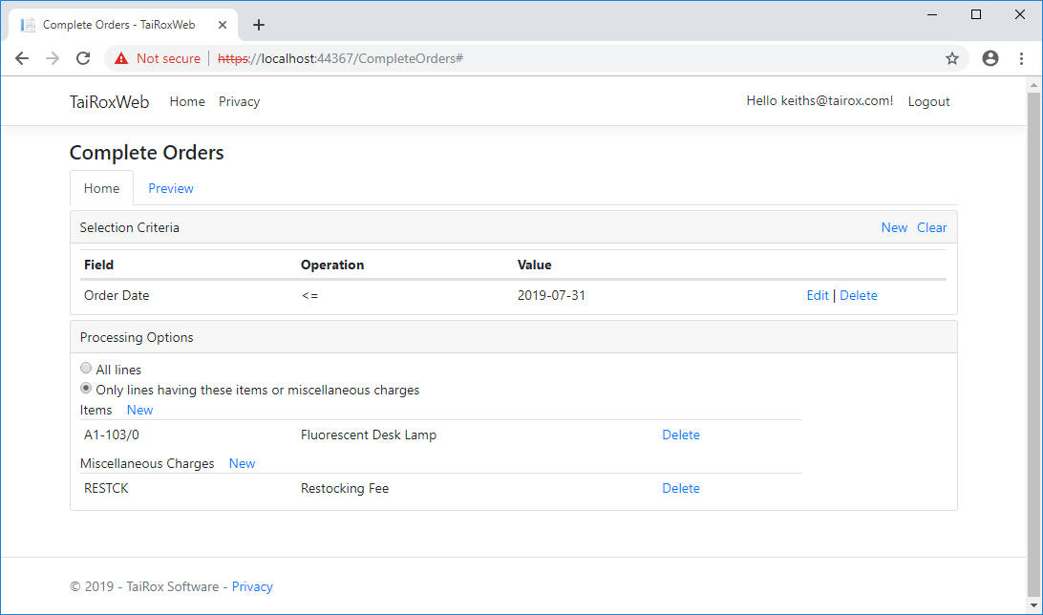
TaiRox CRMc

Slide 15
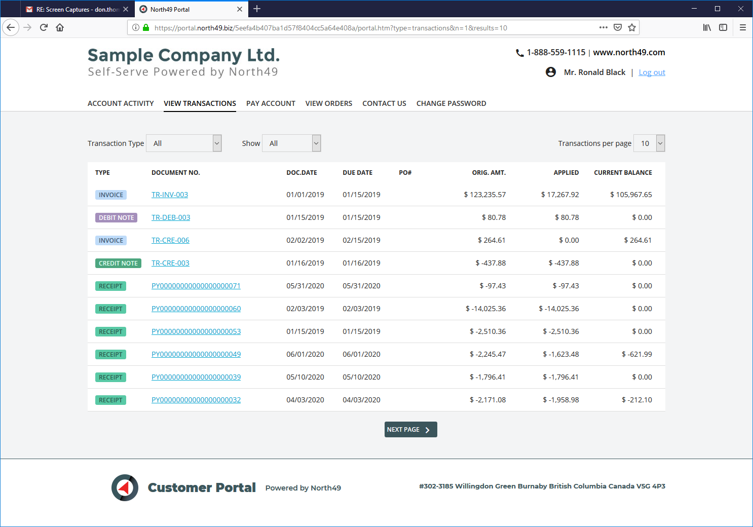
TaiRox CRMc

Slide 16
Learn More About CRM
https://www.tairox.com/tairox-crm-for-sage-300-erp-accpac.html
http://www.youtube.com/TaiRoxSoftware/
http://www.tairox.com

