Slide 1

TaiRox Fast Products
Don Thomson, CEO, Accpac Founder

Slide 2
Fast TaiRox Products
Install Check
Fast DBTools
Fast Clear History
Fast Data Integrity
Copy Company

Slide 3
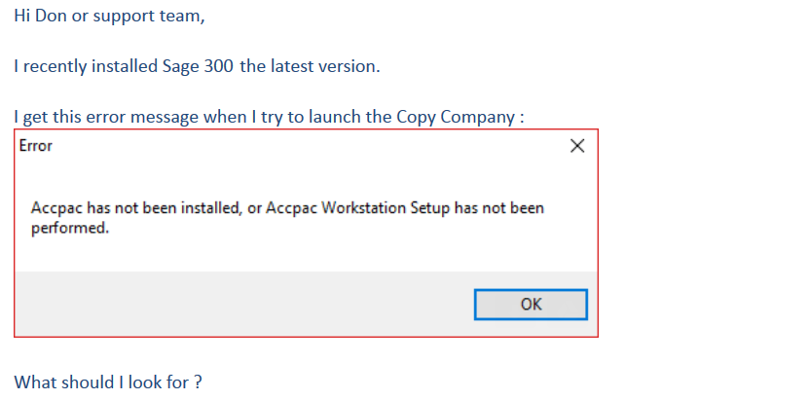
Install Check & Support Issues

Slide 4
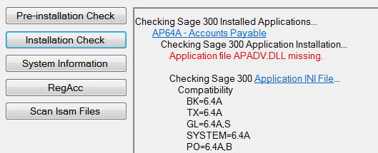
Install Check
Problem: Sage 300 hangs or crashes, sometimes
Cause: Overly aggressive anti-malware program has quarantined APADV.DLL

Slide 5
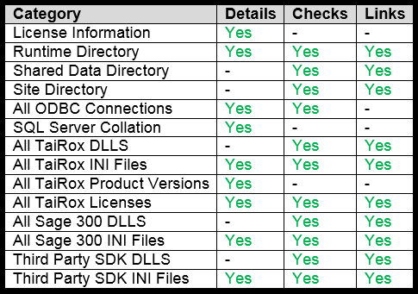
Install Check

Slide 6
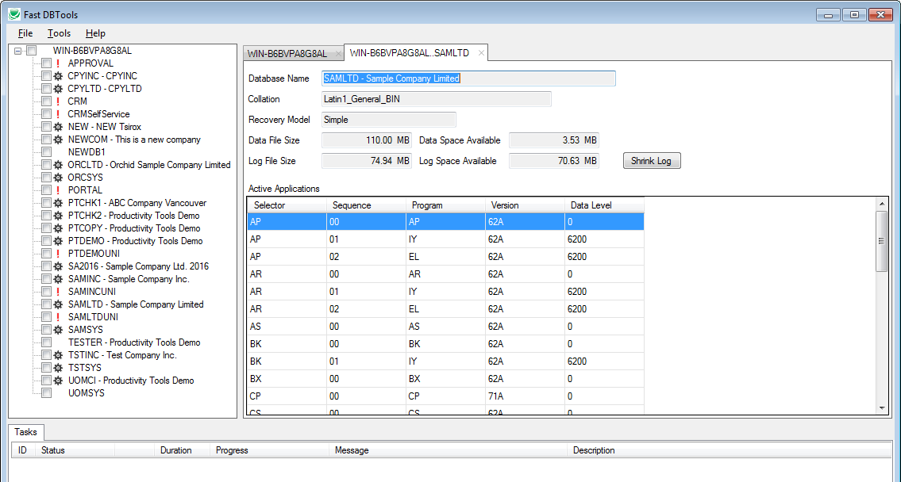
Fast DBTools

Slide 7
Fast DBTools Notes
3x to 4x faster DBLoads (larger databases)
Uses multiple CPU cores (threads) for faster DBDumps
DBDump any number of databases at once
Has a de-activate function
View large datasets without loading into a database
Provides a Sage 300 centric view of a SQL instance
Will DBDump in REC or CSV format
Recover unused database space with 1 click
Detects changes to Sage 300 databases
Stores collation changes

Slide 8
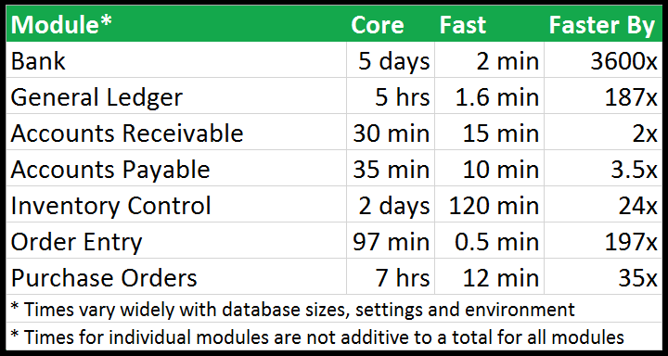
Fast Clear History – How Fast?
I/C and O/E: Sage 300 doesn’t use the database layer
A/R and A/P: Sage 300 does use the database layer, somewhat

Slide 9
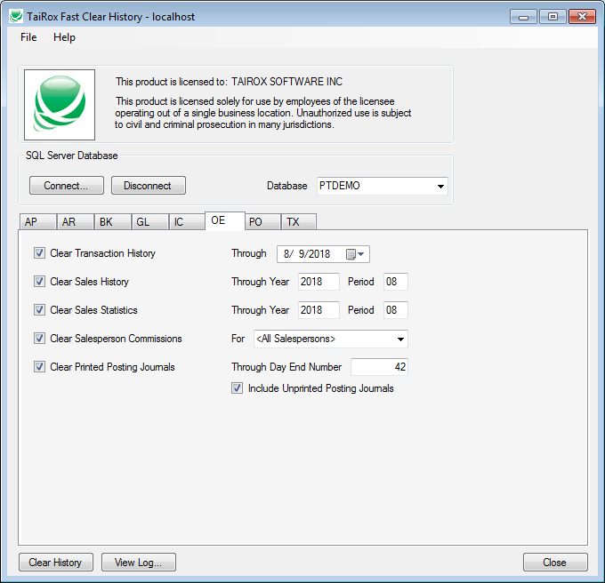
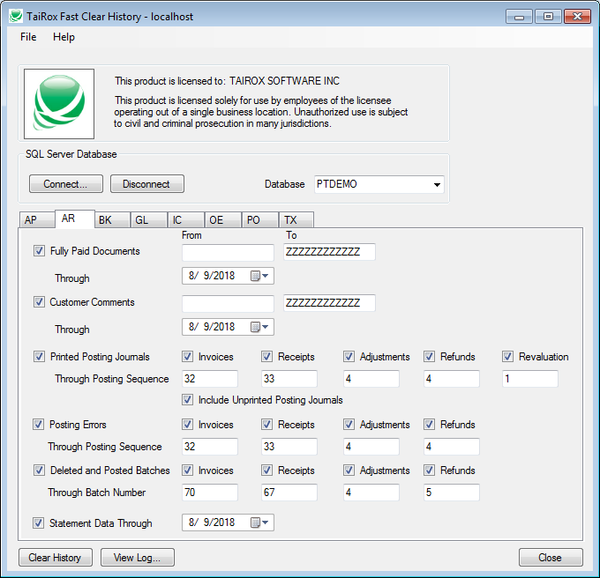
Fast Clear History

Slide 10
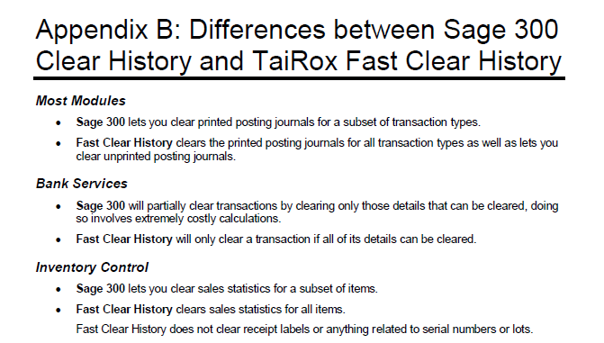
Fast Clear History Notes

Slide 11
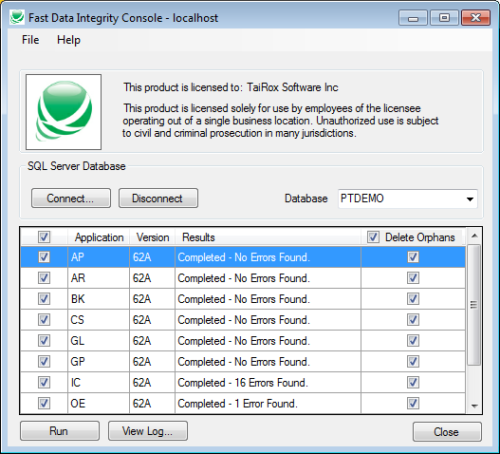
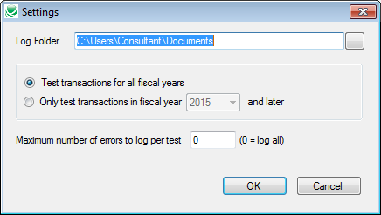
Fast Data Integrity

Slide 12
Fast DIC Tech Notes
How much Faster? Think 6 hours in 6 minutes.
  Most performance boost for large databases with few errors
How? Fast DIC only asks SQL Server for “bad” rows
Fast DIC checks:
  All orphan and foreign key problems
  All GLARAPICOE header/detail totals
  Missing required optional fields
Fast DIC does not check for “illegal characters”

Slide 13
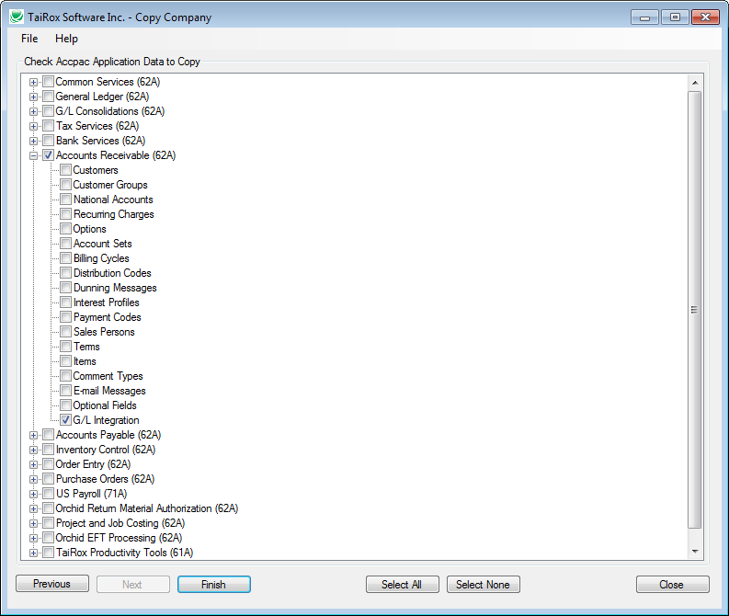
Copy Company

Slide 14
Copy Company Tech Notes
Uses Sage 300 Objects
  Insures the result is valid
  Requires 2 Lanpaks in early versions of Sage 300
Audit Logger, Orchid Extender
  Programs that sub-class Sage 300 views
Use Copy Company in a Clean Environment!
  Problems? Run TaiRox Install Check

Slide 15
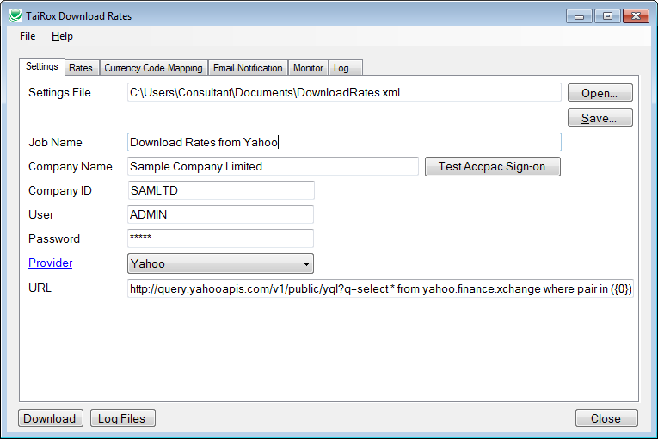
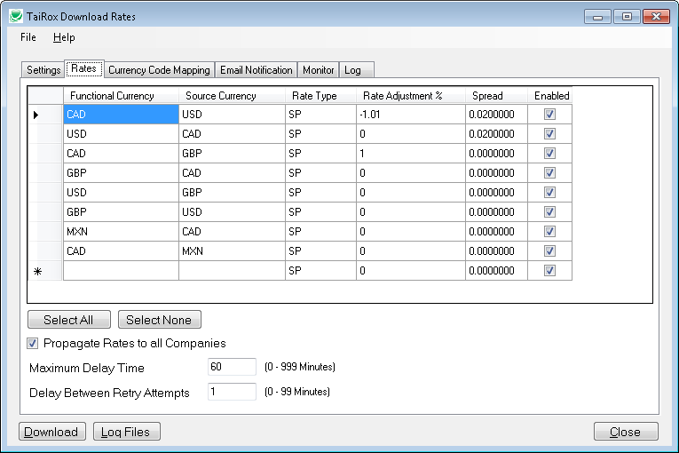
Download Rates

Slide 16
Download Rates Tech Notes
Government RSS Feeds
  Bank of Canada, US Fed, Reserve Bank of Australia
  GBP to EUR is constructed from 2 CAD/USD/AUD rates
  No historical rates are provided
  Rates are available at a specific time of day (usually)
Commercial Feeds
  Currencylayer, Oanda (no longer supported)
  Historical rates are provided
Free Feeds
  Yahoo!, Google (no longer supported)
  Rates are “rates of the moment”, not for a specific day
Scheduled Task – plan time carefully for occasional outages!

Slide 17
Download Rates Tech Notes
Download Rates uses Sage 300 Rate Types
  There can be more than one rate for 2 currencies
Download Rates will adjust a rate by a percentage
  To get a more accurate valuation of receivables or payables
Download Rates will store “spread”
  The spread feature is usable when only set up 1 time
Non-ISO code is used in Sage 300 database?
  Download Rates will re-map

Slide 18
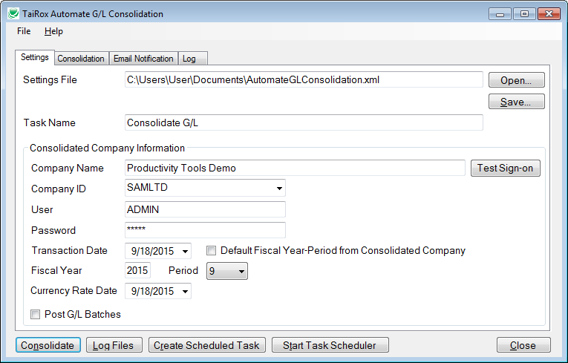
Automate G/L Consolidation

Slide 19
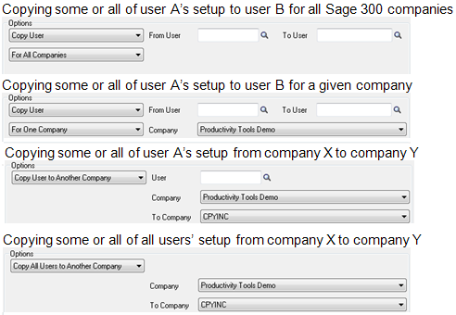
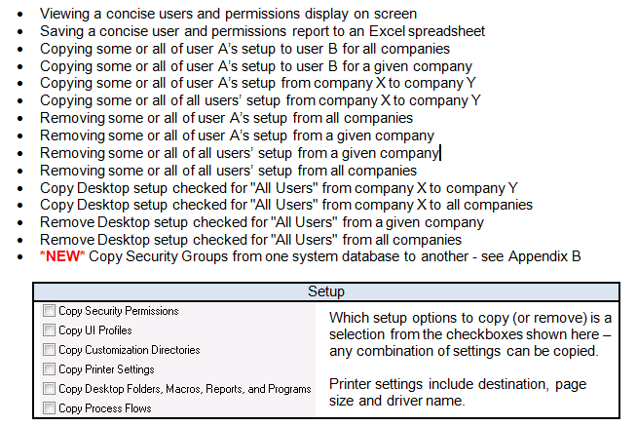
SOX User Management

Slide 20
SOX User Management Tech Notes
The rights didn’t get copied?
  SOX User Management called the propagate function
  The propagate function was blocked and reported no errors
  Run propagate from DB Setup to fix
What’s the difference between “All Users” and “Everyone”?
  Desktop settings are stored in subdirectories of USER
  When you create a folder on a desktop and tell Sage 300 it is for “All Users”, that setting is kept in a special subdirectory of USER, _EVERYONE

Slide 21
