Slide 1
What’s New at TaiRox
Don Thomson, CEO

Slide 2
TaiRox Videos at
Morgan
Thomas

Slide 3
TaiRox Documentation Refresh

Slide 4
Embedded TaiRox Videos
PDF Files:
Brochure
User Guide

Slide 5
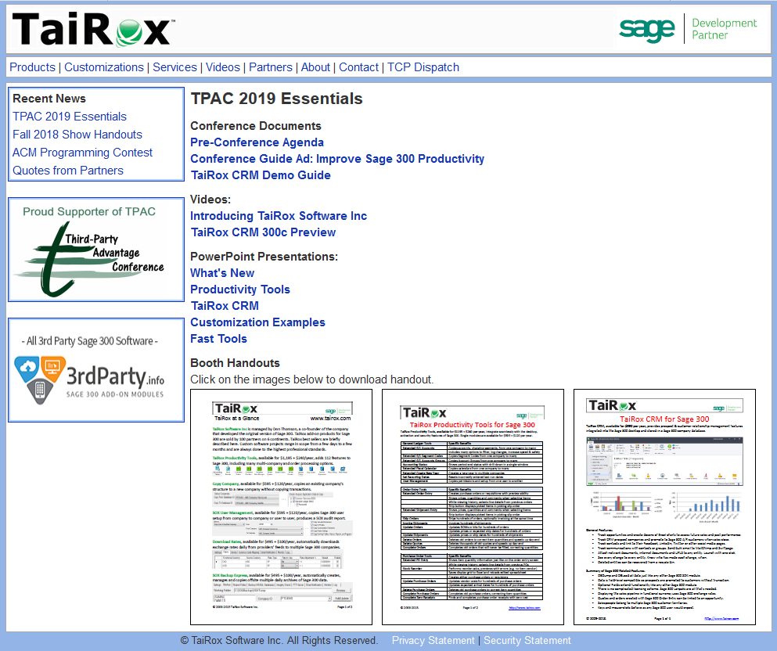
TPAC Handouts at www.tairox.com

Slide 6
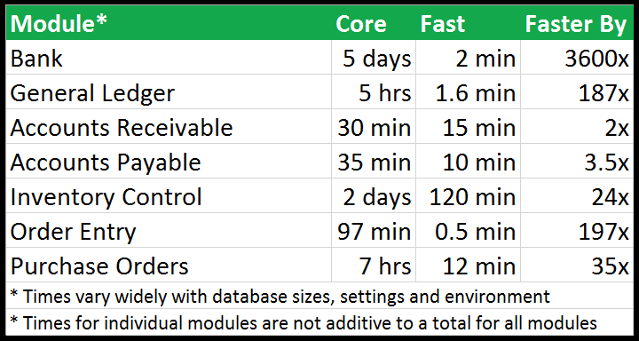
Fast Clear History – How Fast?
I/C and O/E: Sage 300 doesn’t use the database layer
A/R and A/P: Sage 300 does use the database layer, somewhat

Slide 7
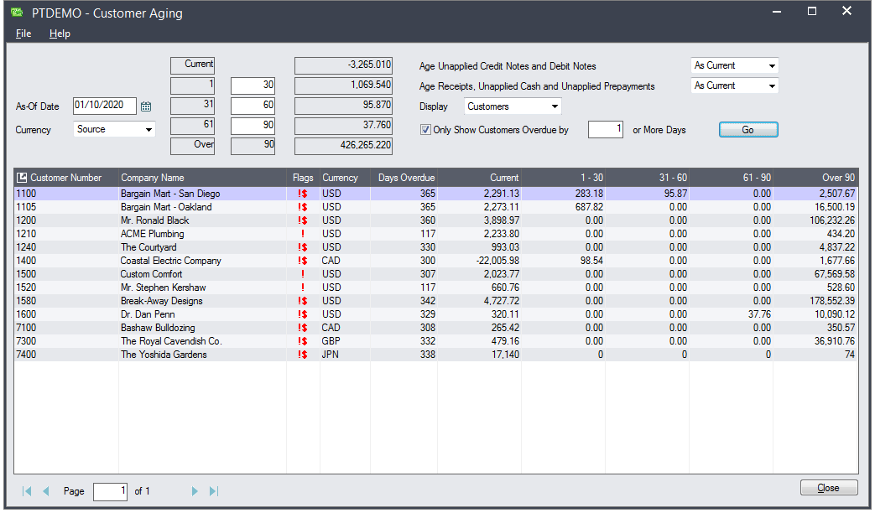
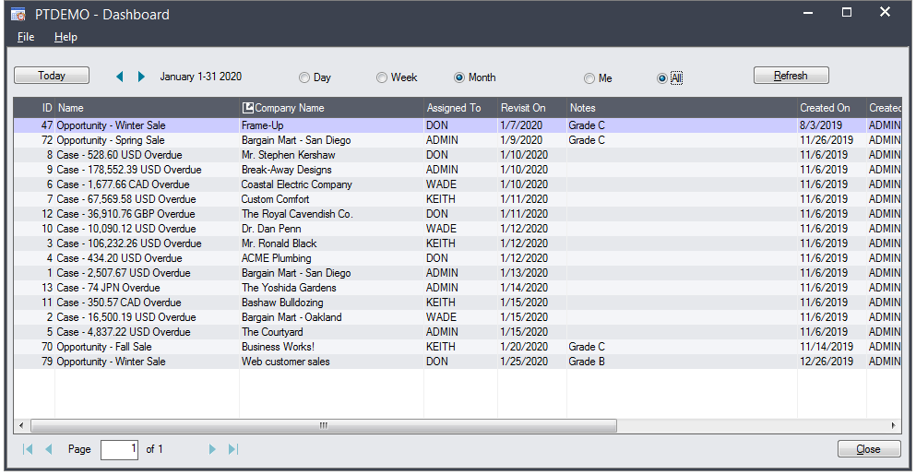
Customer Aging and Cases

Slide 8
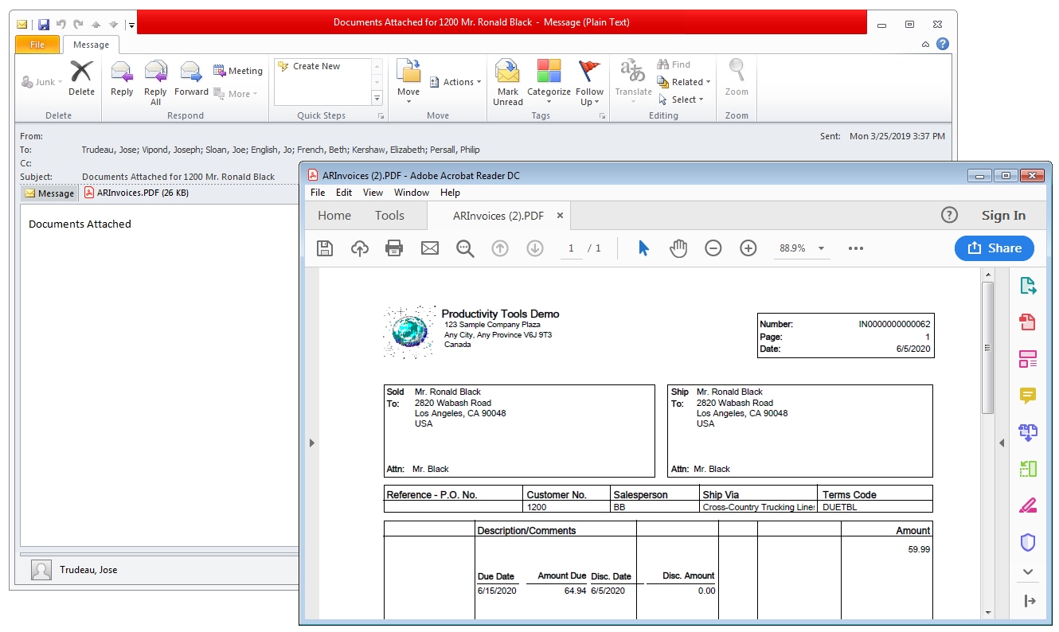
Send Documents to Multiple Contacts

Slide 9
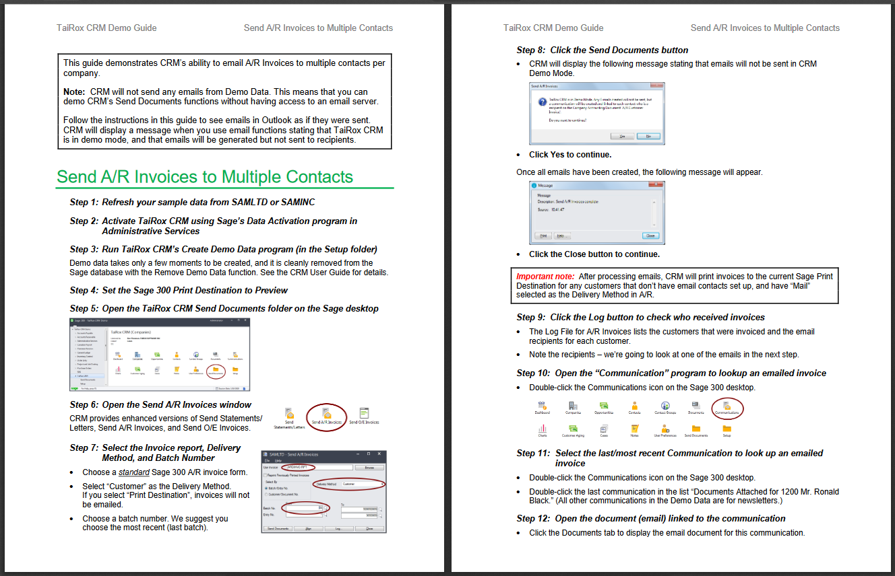
Demonstration Guide

Slide 10
TaiRox CRM 300c

Slide 11
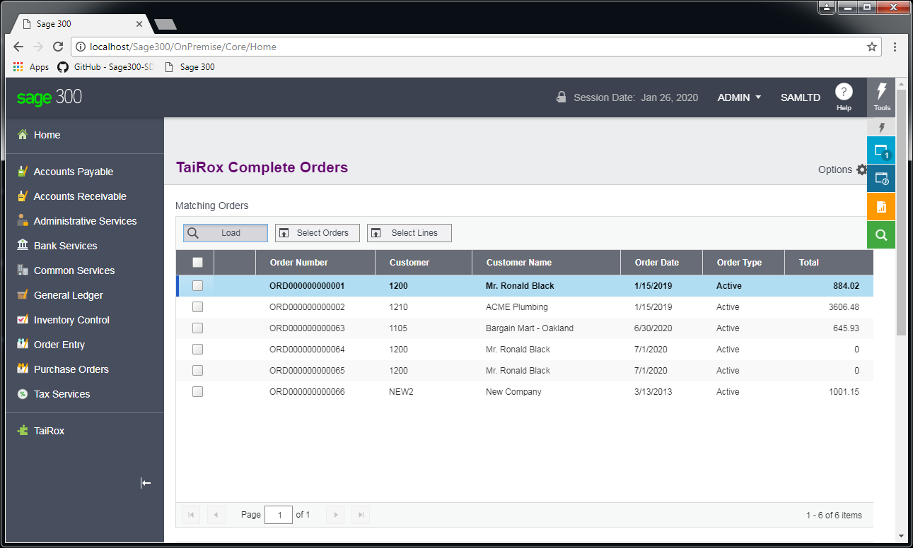
Productivity Tools 300c

Slide 12
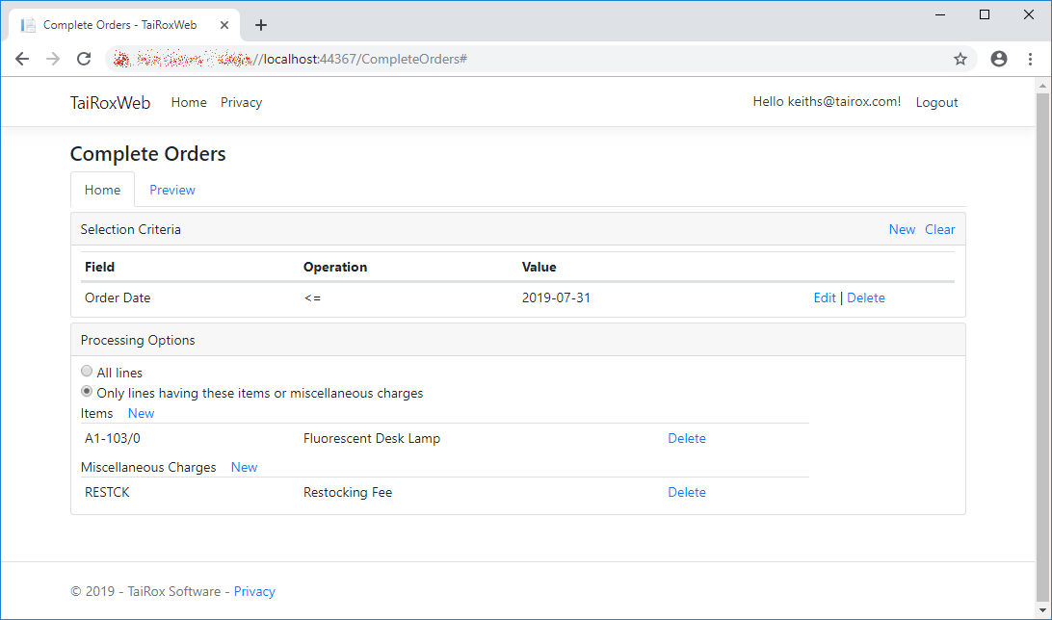
Productivity Tools 300c

Slide 13
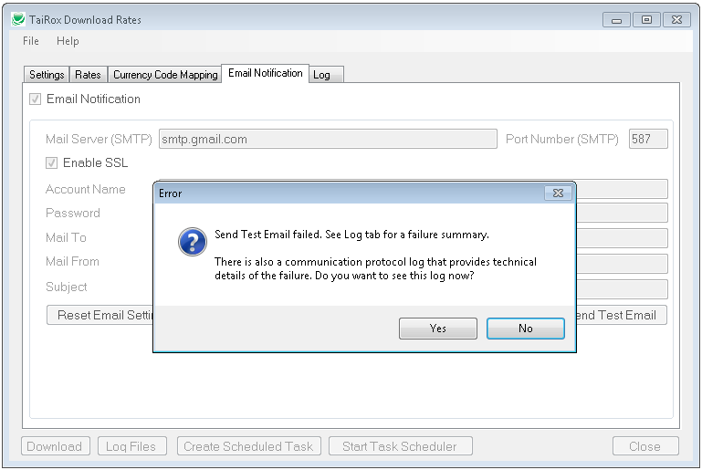
Diagnosing Email Problems

Slide 14
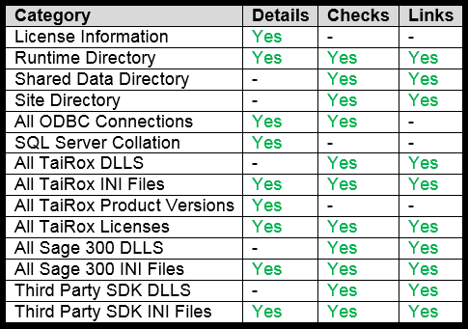
Install Check

Slide 15
Learn More About TaiRox
https://www.tairox.com/tairox-productivity-tools-for-sage-300-erp-accpac.html
https://www.tairox.com/tairox-crm-for-sage-300-erp-accpac.html
http://www.youtube.com/TaiRoxSoftware/
http://www.tairox.com

